Slide 1


ARES – GO KITS
Amateur Radio Emergency Service
Presented by
Woody Linton VE3JJA
23 JAN 20

Slide 2



THIS IS NOT A GO KIT

Slide 3
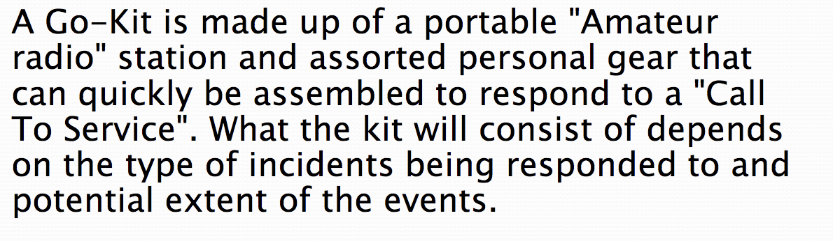

What’s A GO KIT?

Slide 4

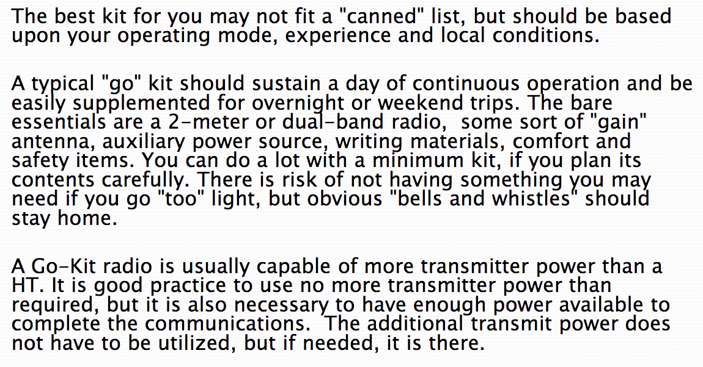
WHAT’S IN A GO KIT

Slide 5
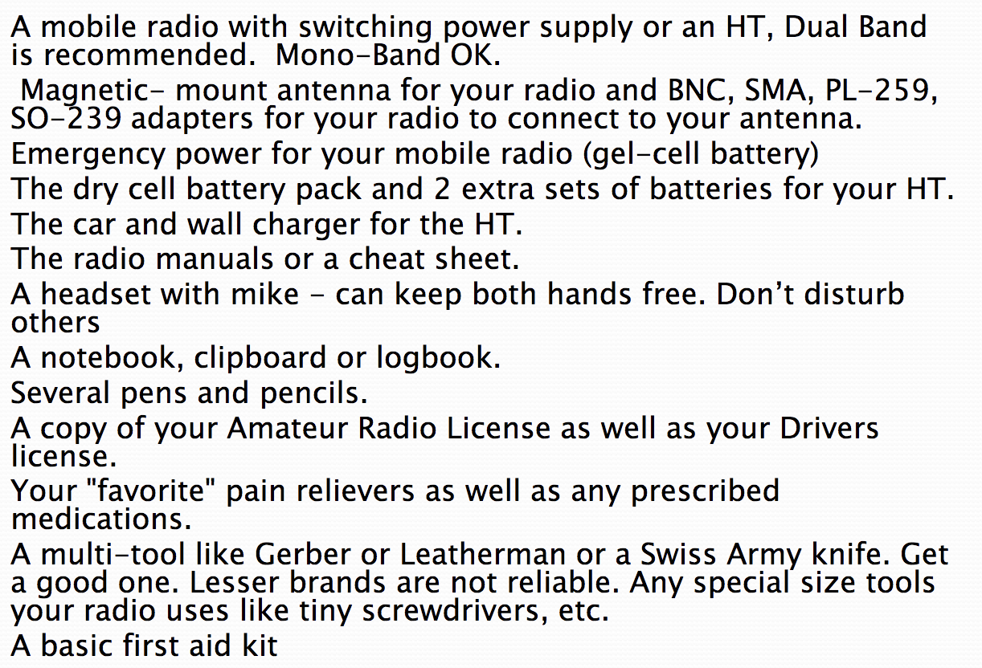
GO KIT RADIO ITEMS

Slide 6
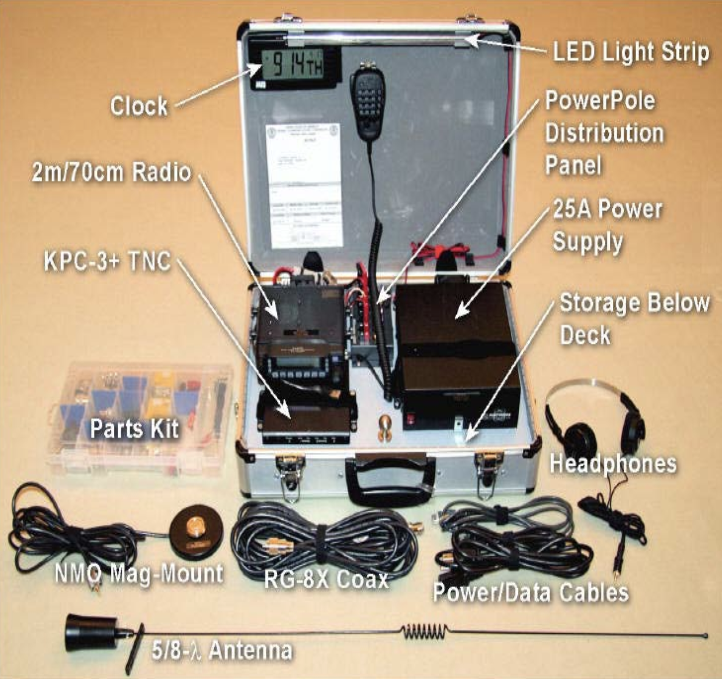
TYPICAL GO KIT

Slide 7
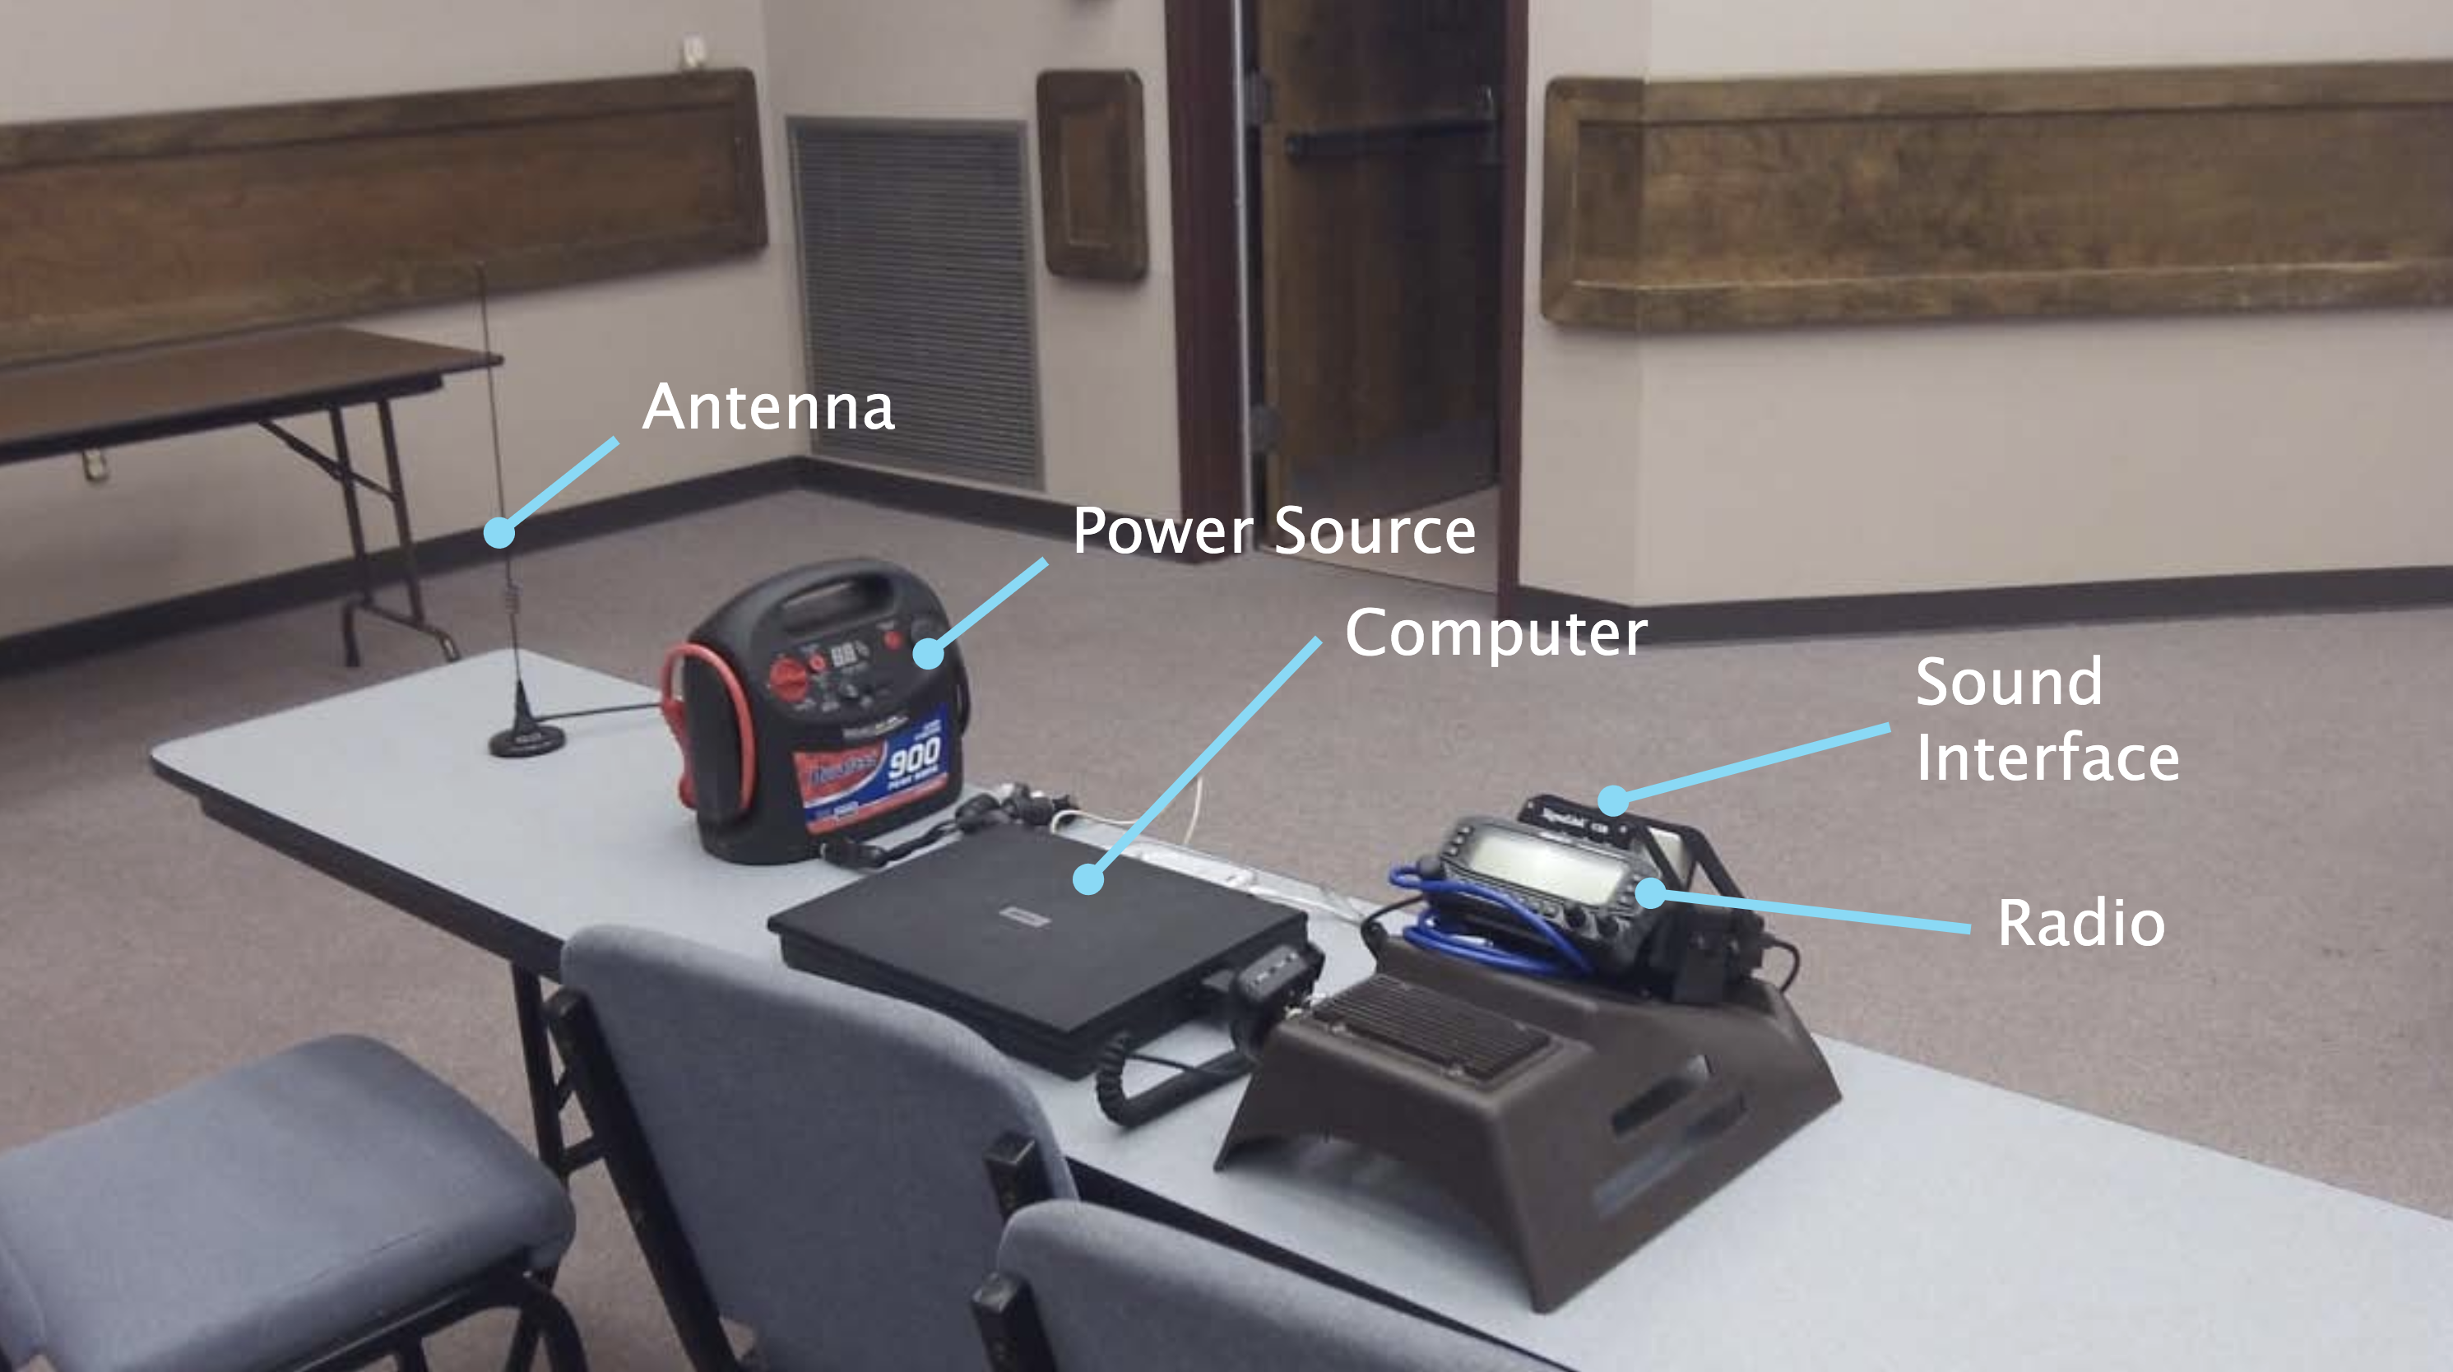
GO KIT EXAMPLES

Slide 8
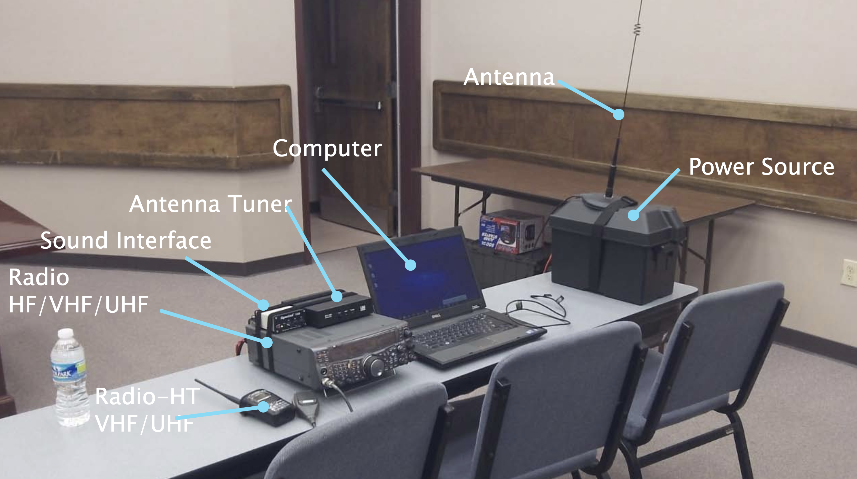
GO IT EXAMPLES

Slide 9
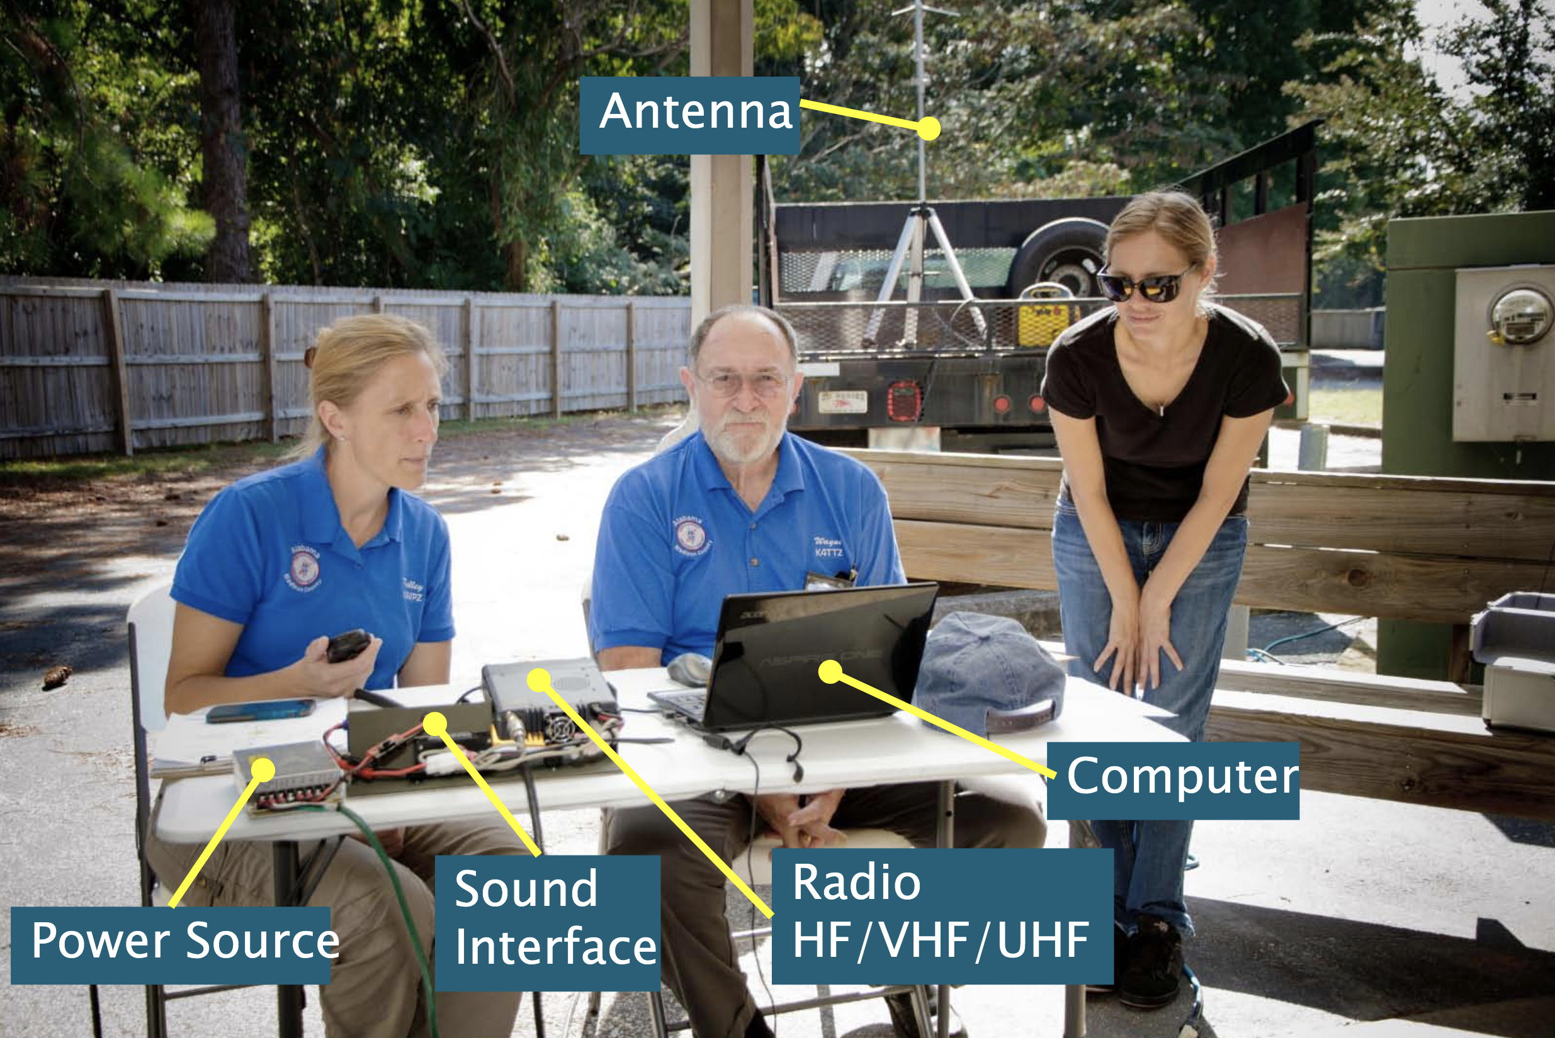
GO KIT EXAMPLES

Slide 10
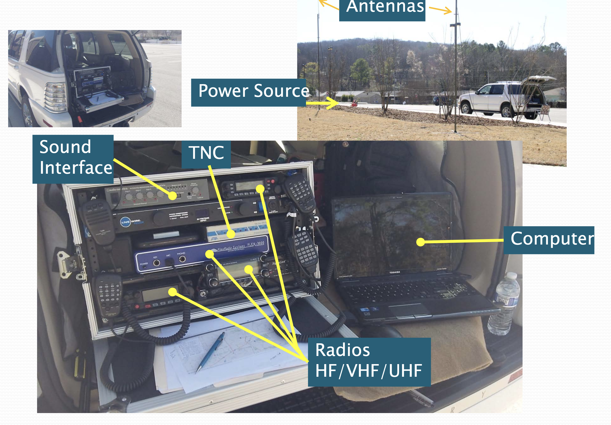
GO KIT EXAMPLES

Slide 11
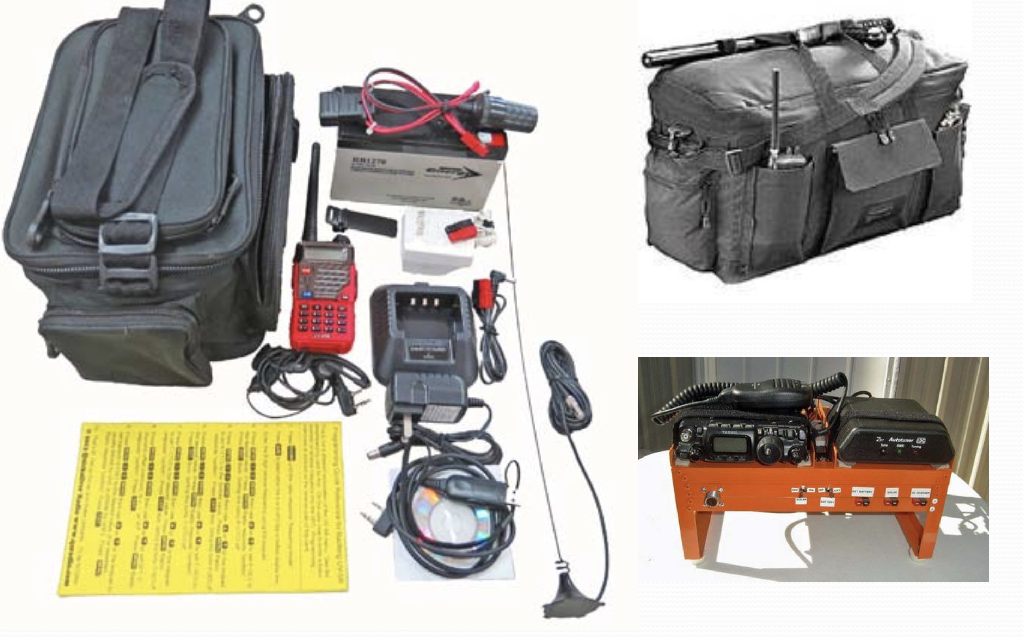
GO KIT EXAMPLES

Slide 12
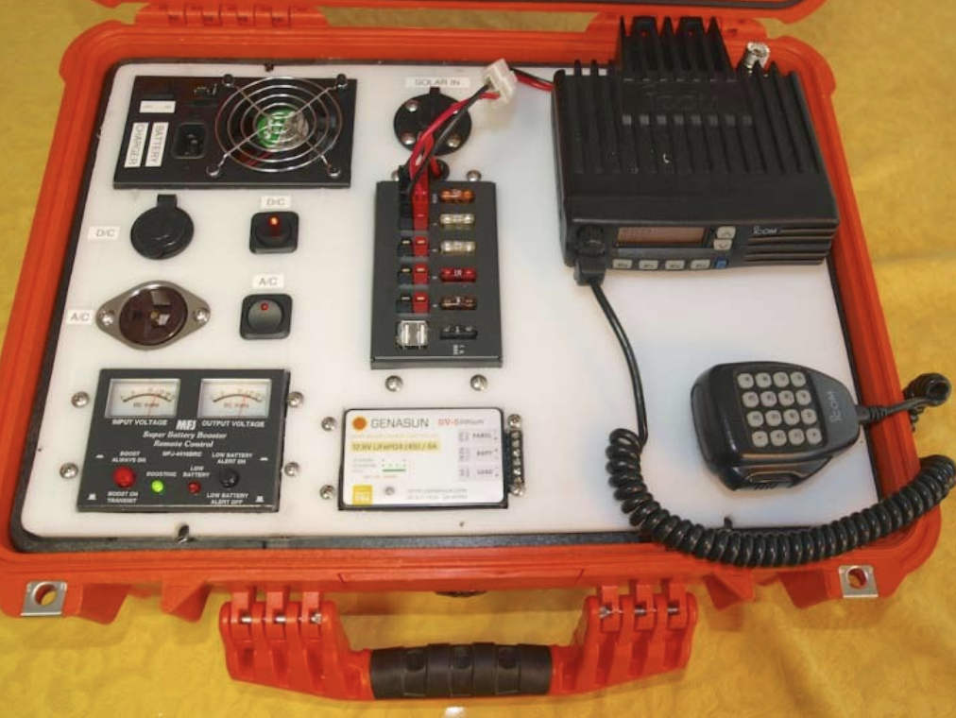
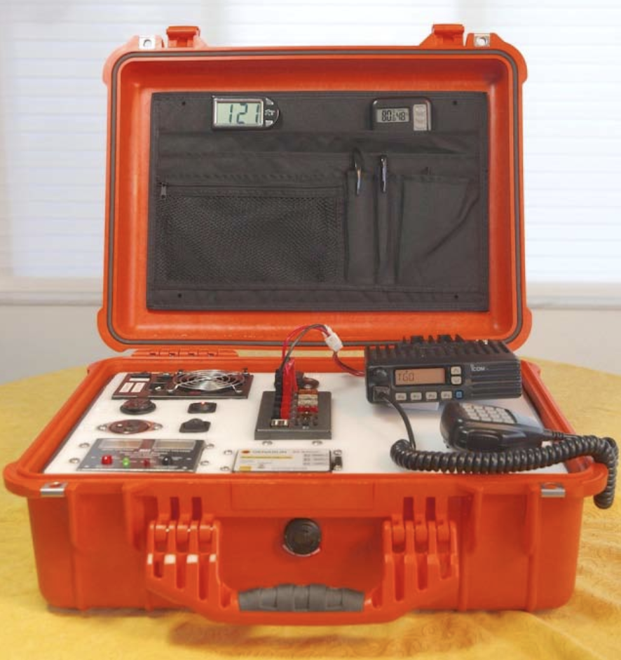
GO KIT EXAMPLES

Slide 13
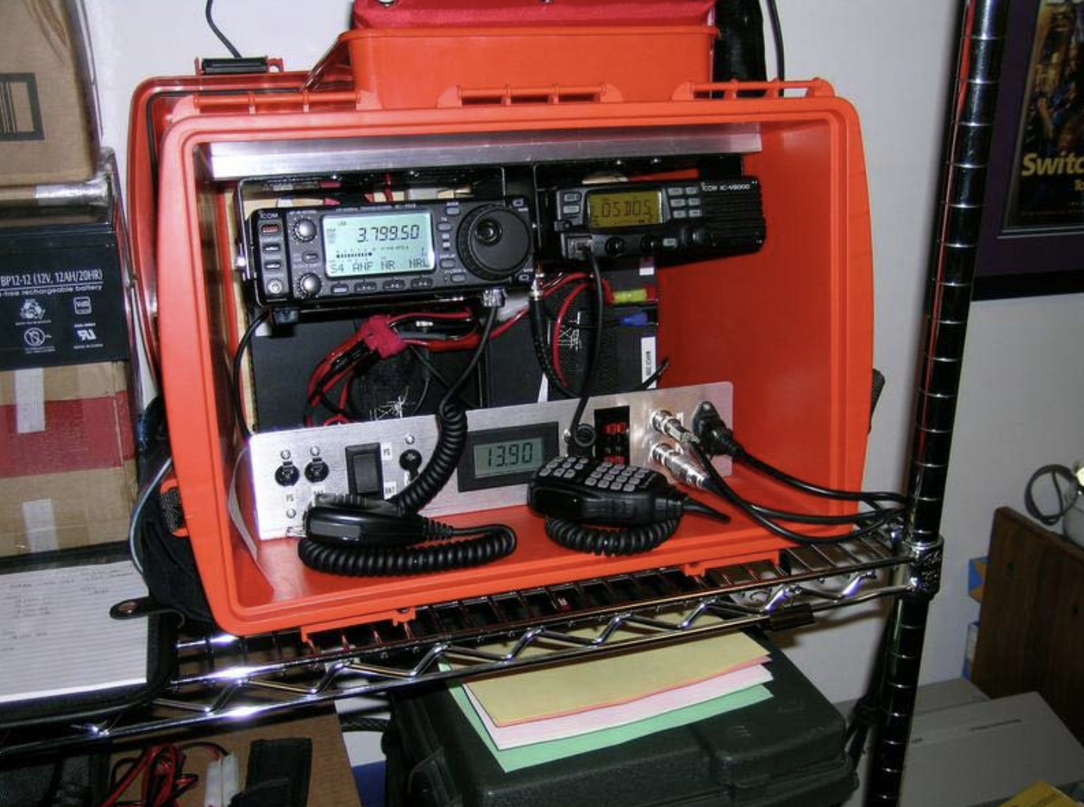
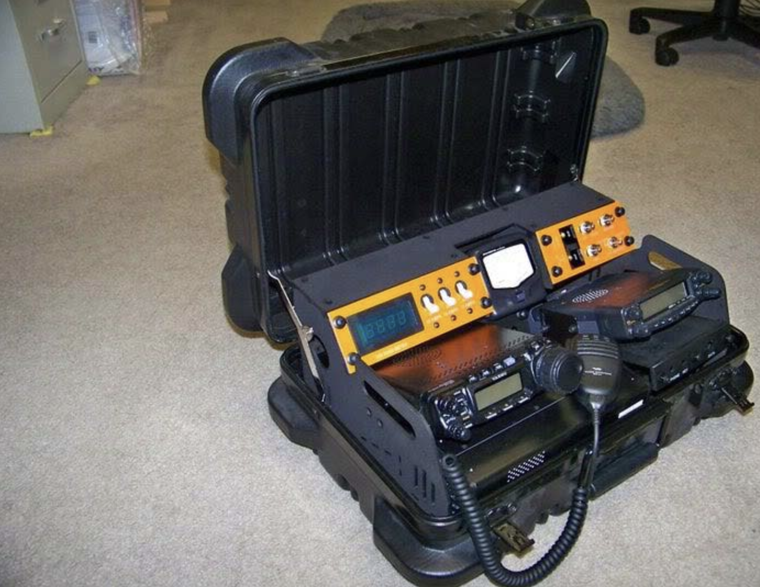
GO KIT EXAMPLES

Slide 14
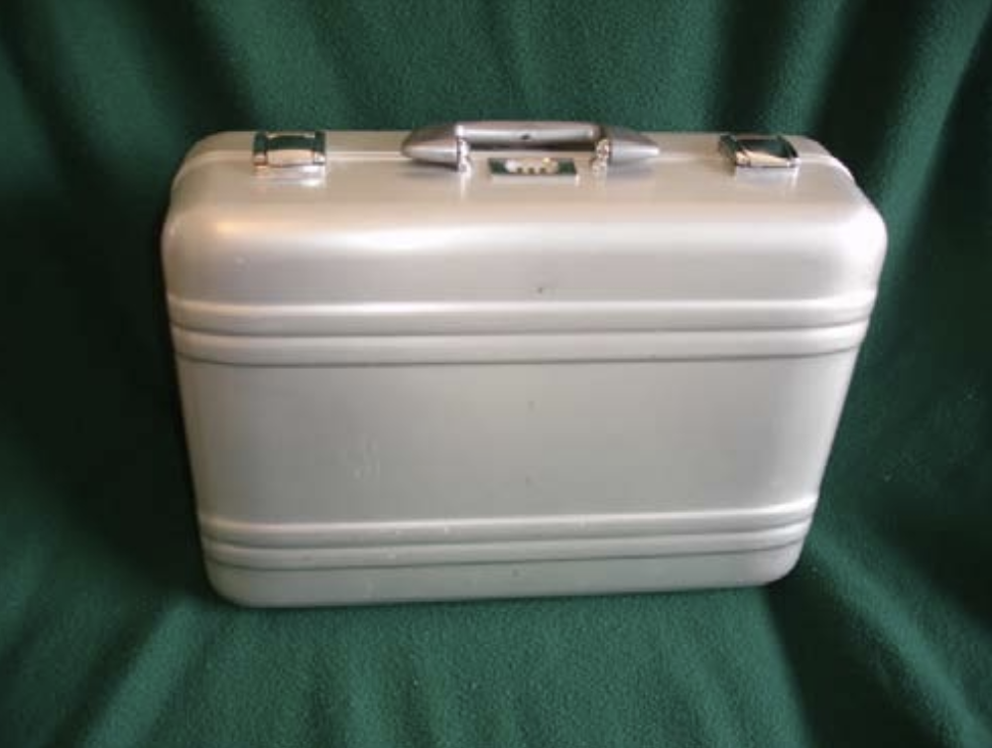
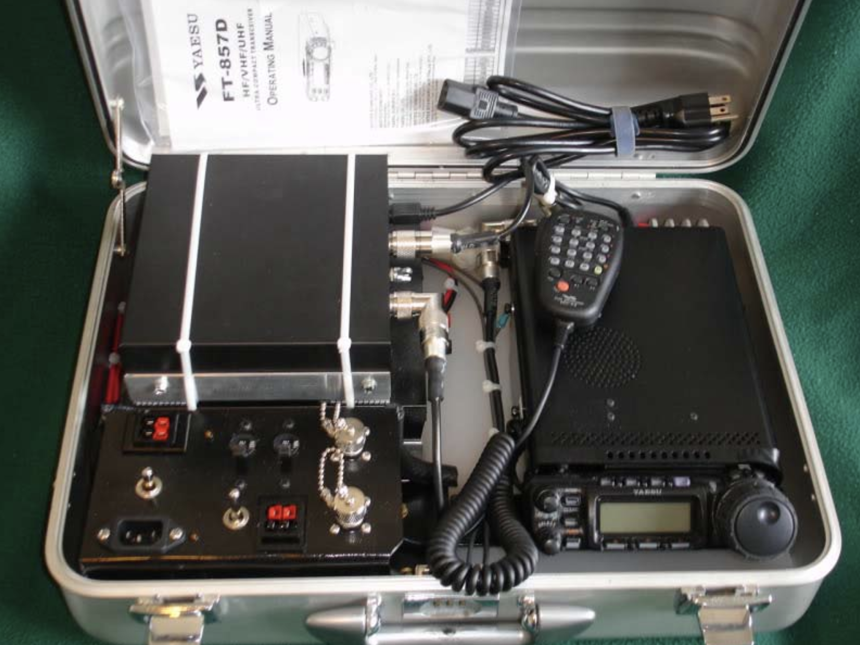
GO KIT EXAMPLES

Slide 15
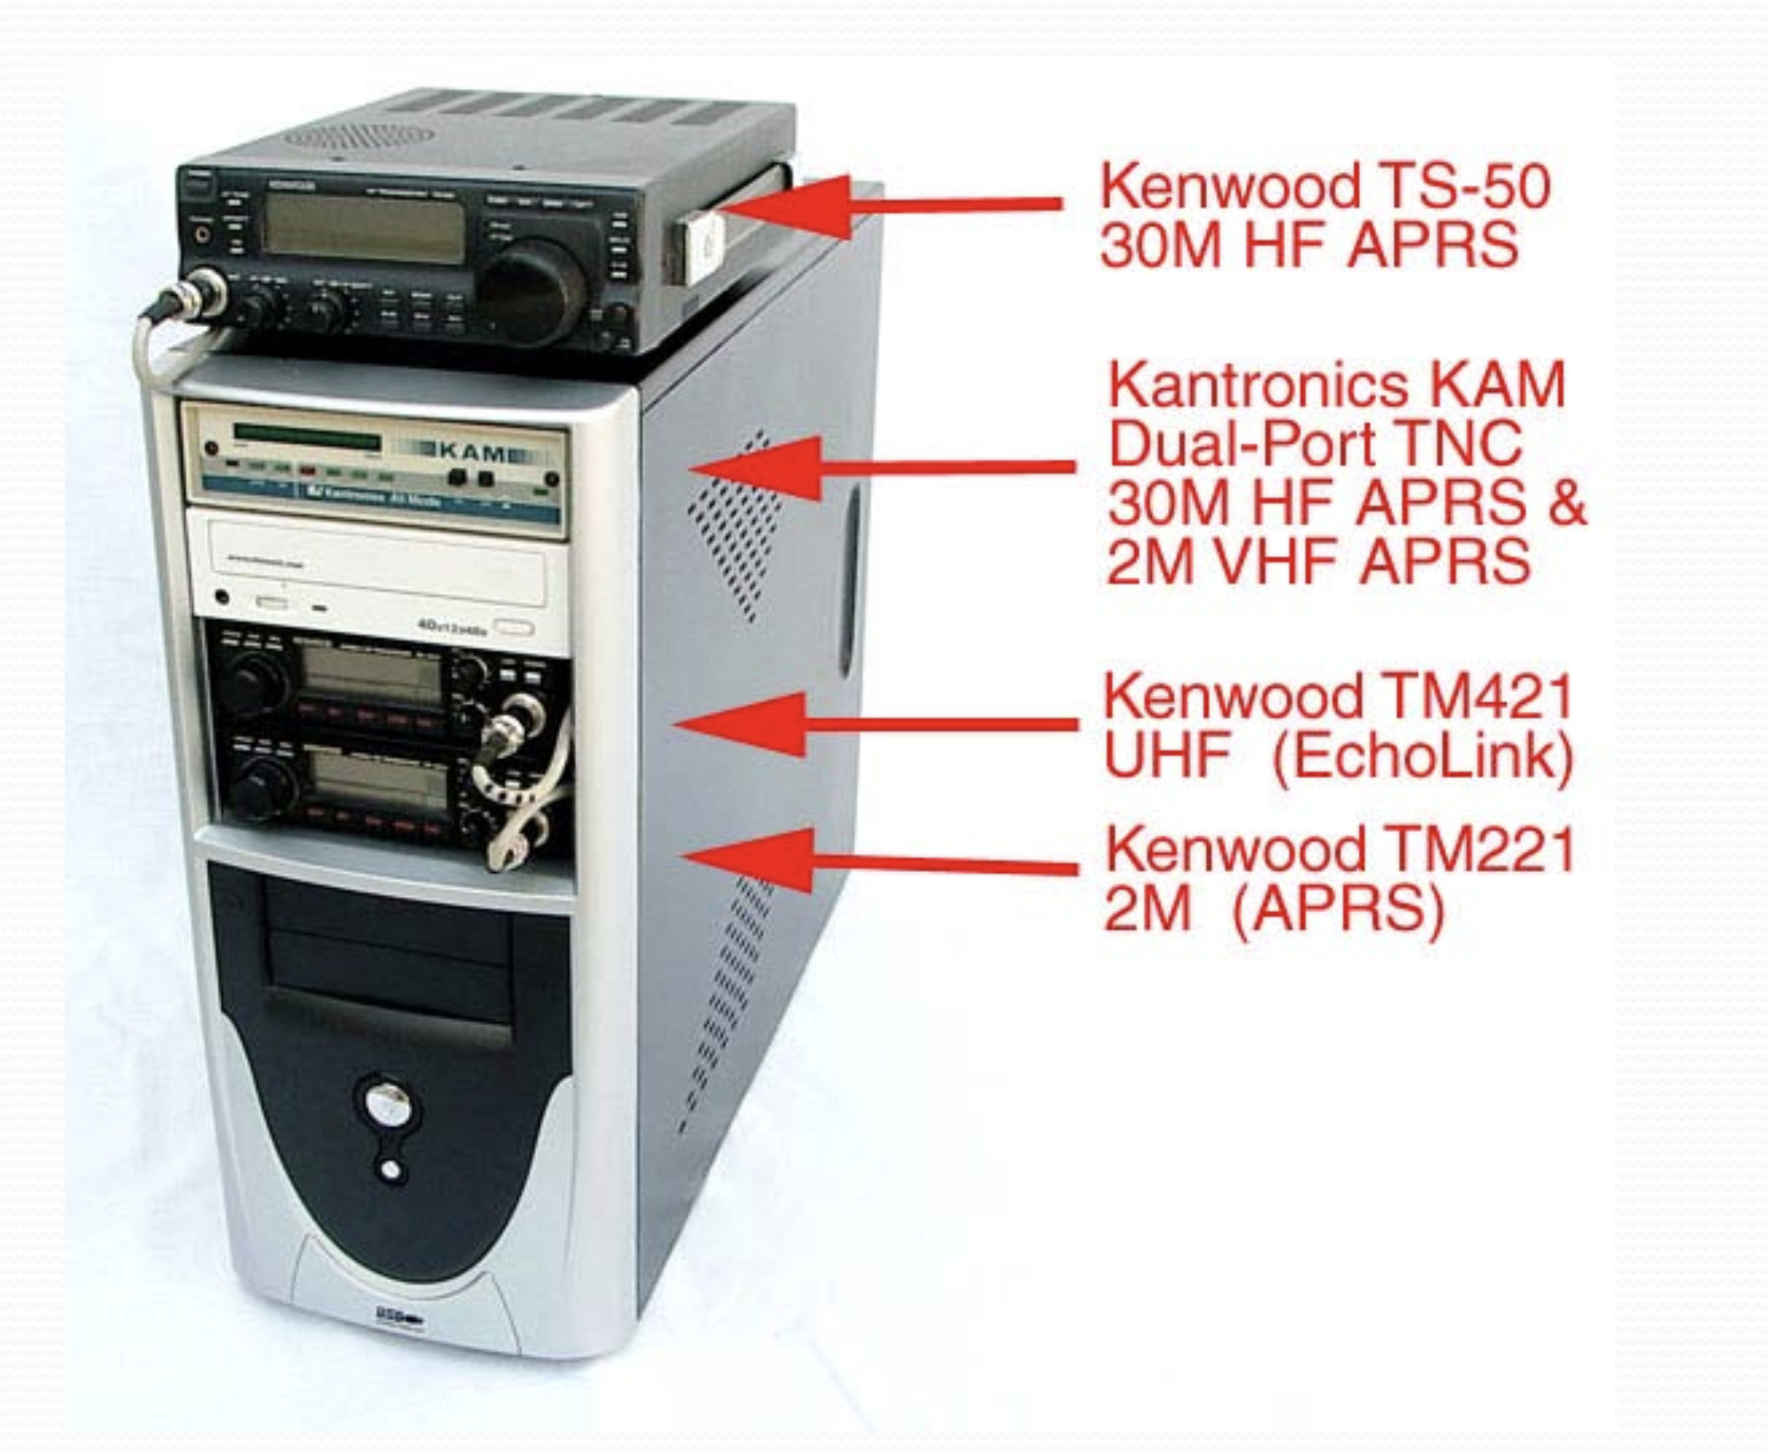
GO KIT EXAMPLES

Slide 16
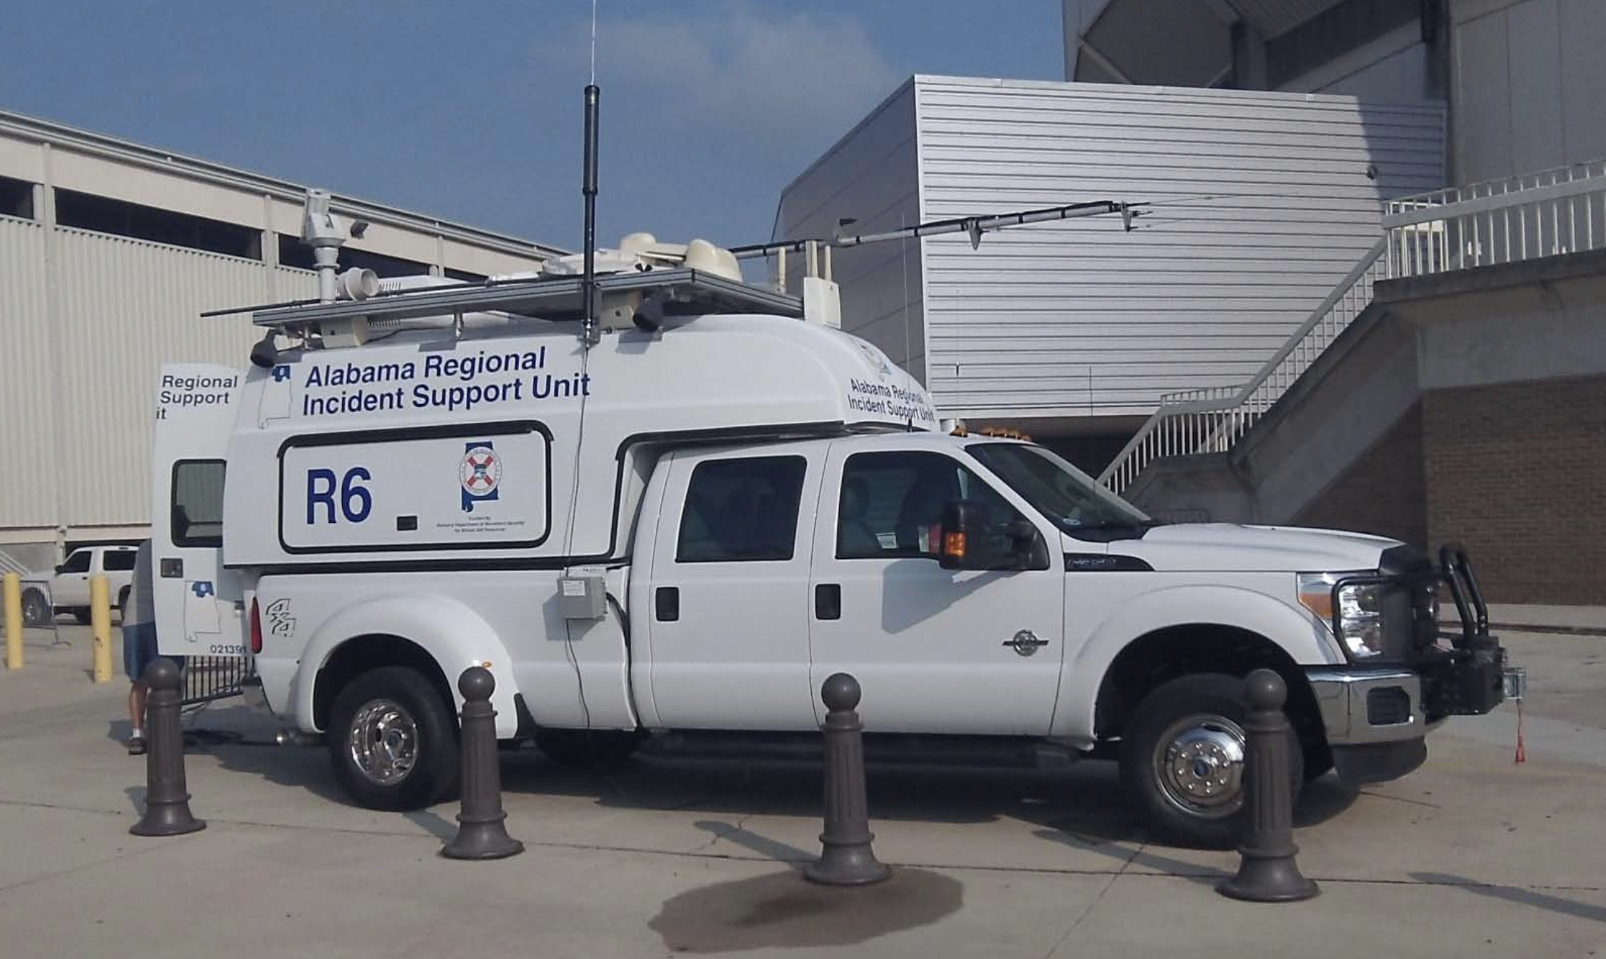
THE ULTIMATE GO KIT

Slide 17
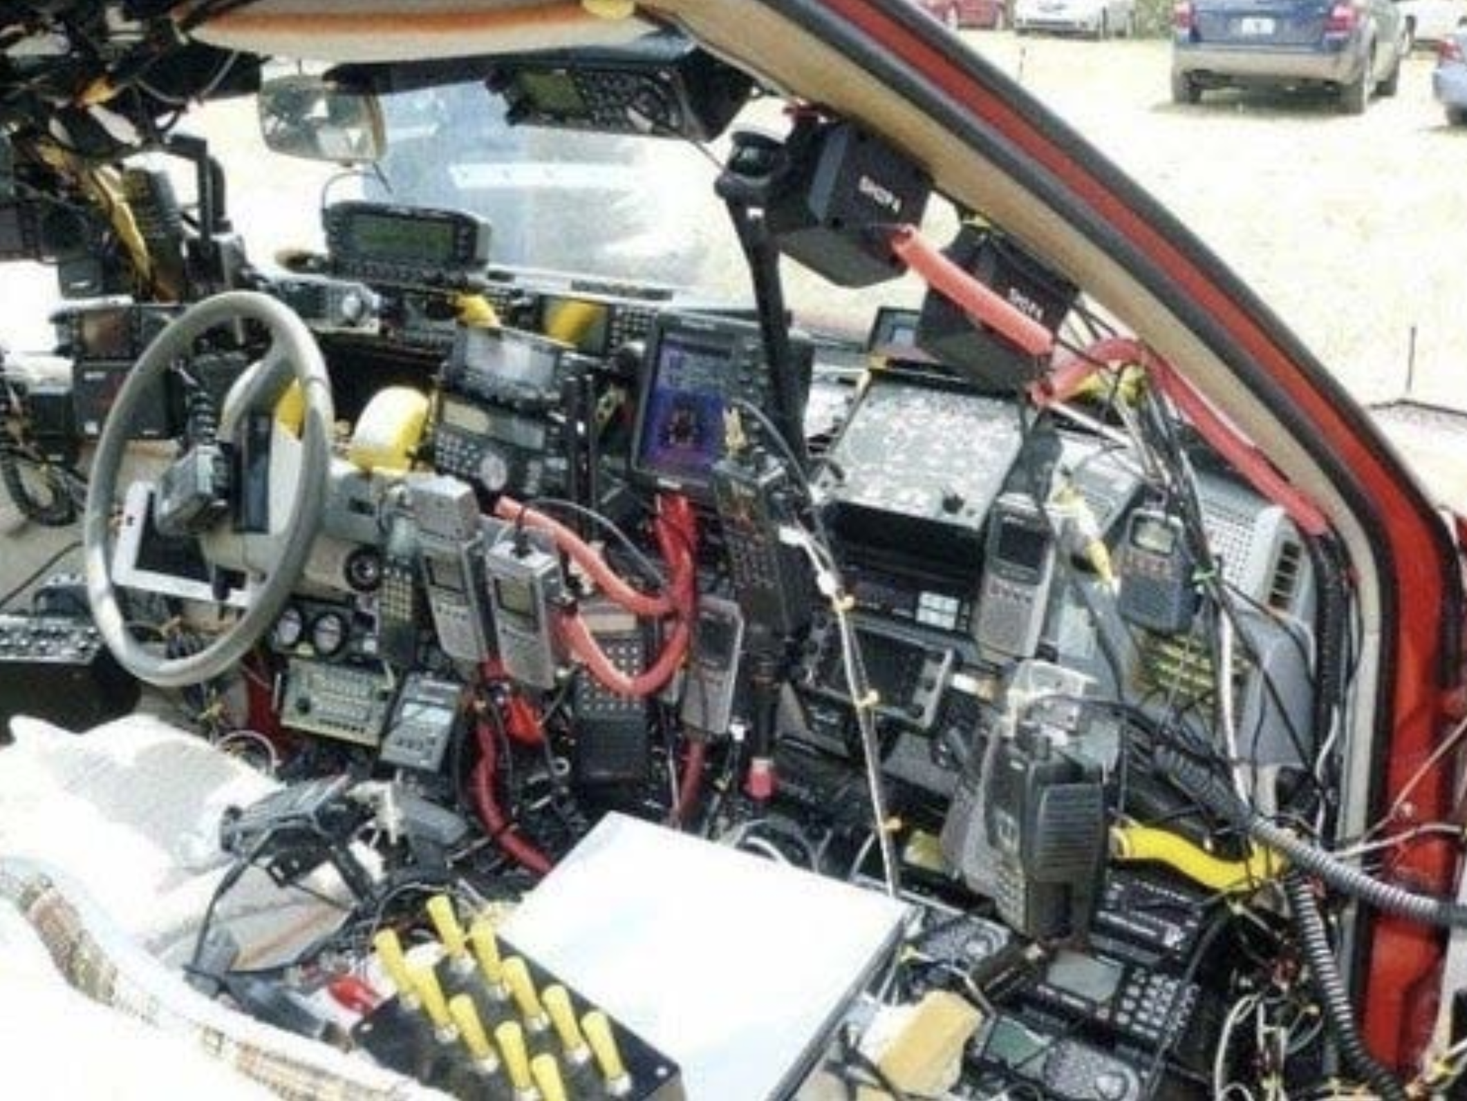
NOT SO ULTIMATE GO KIT

Slide 18
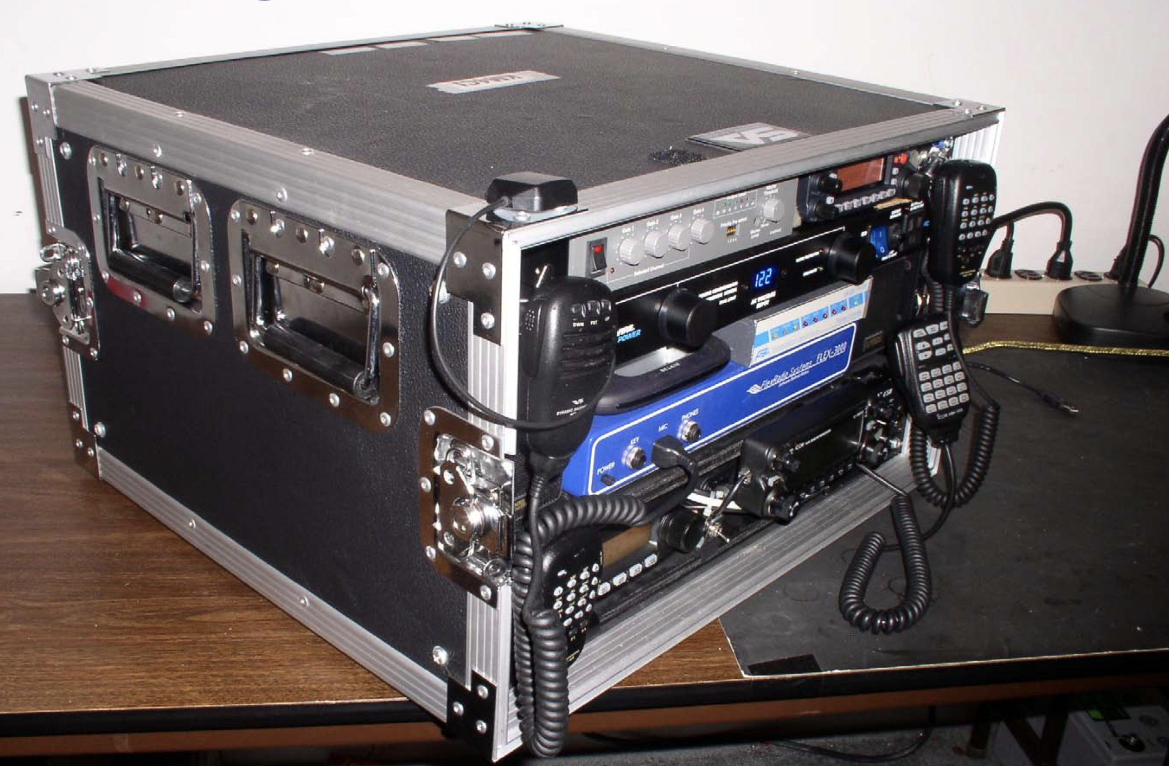
GO KIT EXAMPLE

Slide 19
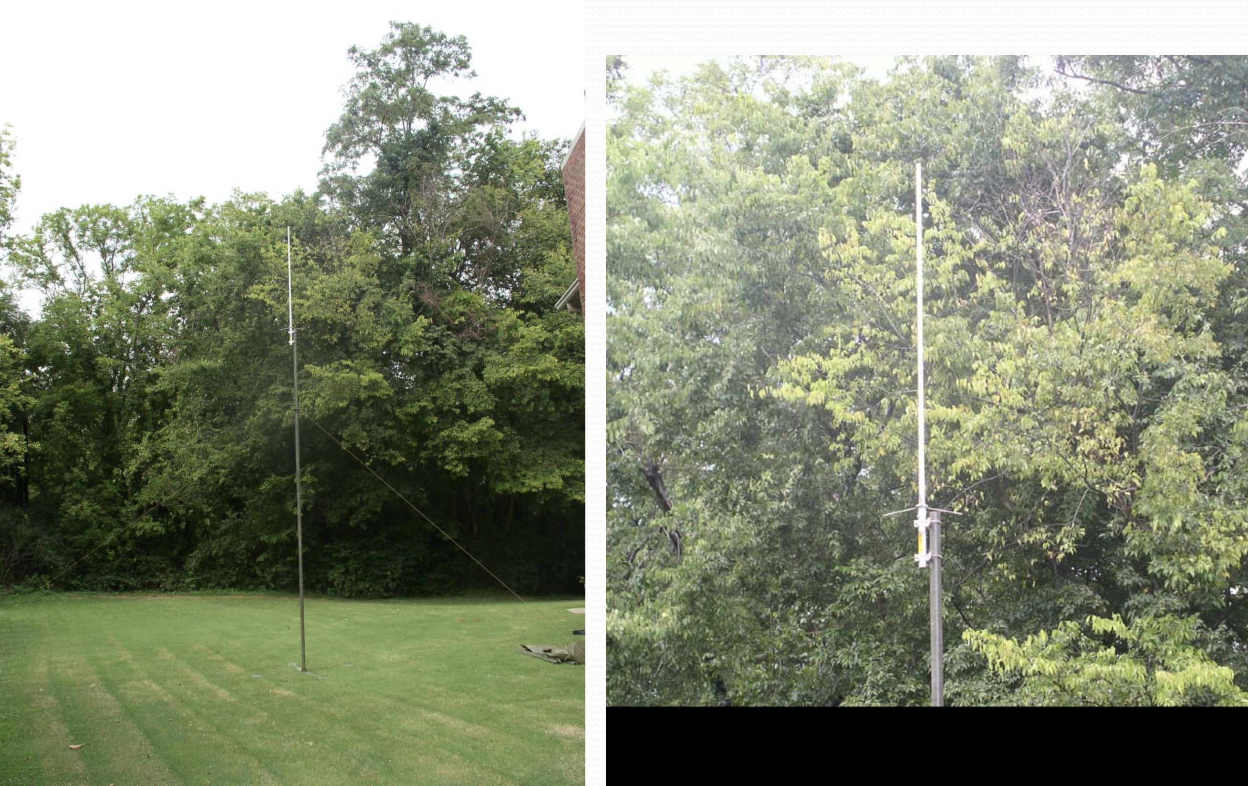
VHF & UHF ANTENNAS

Slide 20
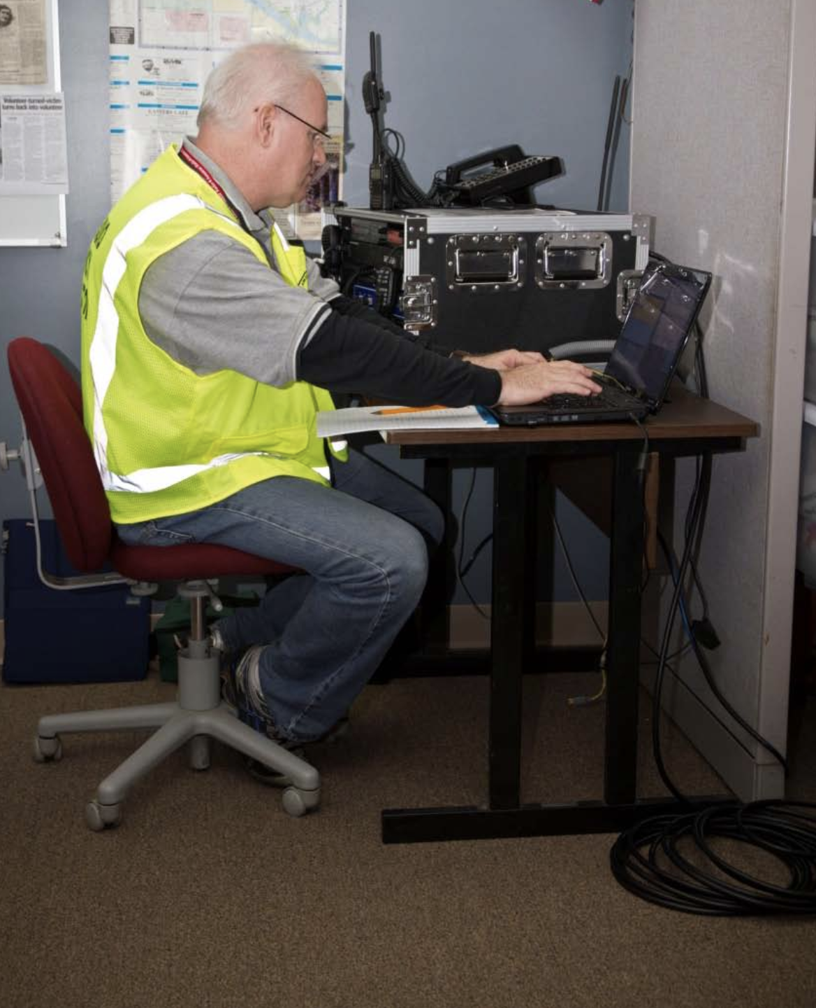
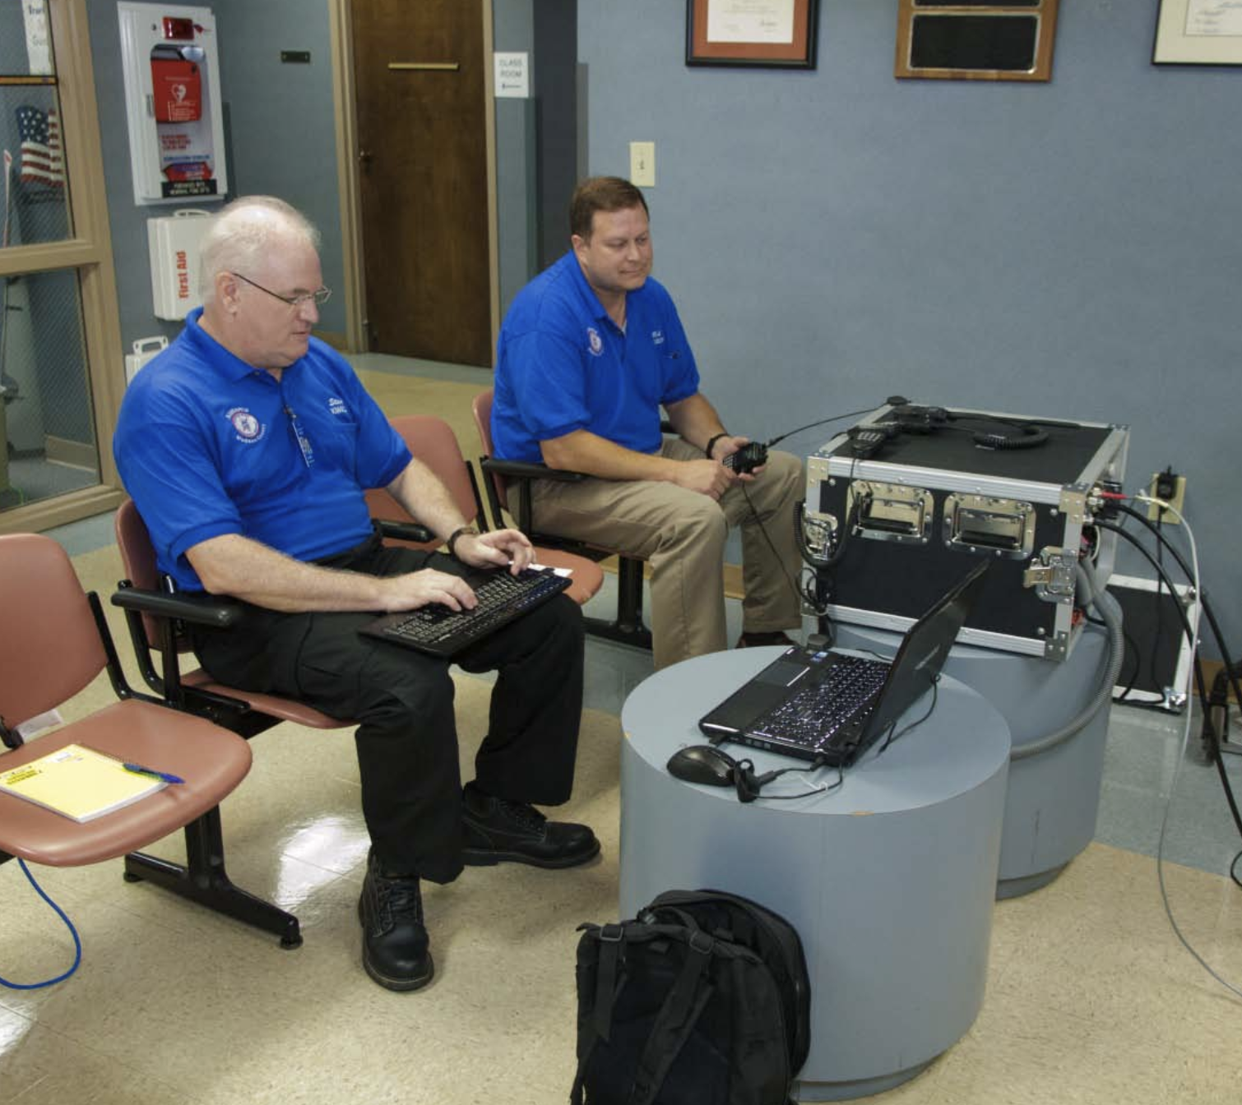
DEPLOYMANT EXAMPLES

Slide 21
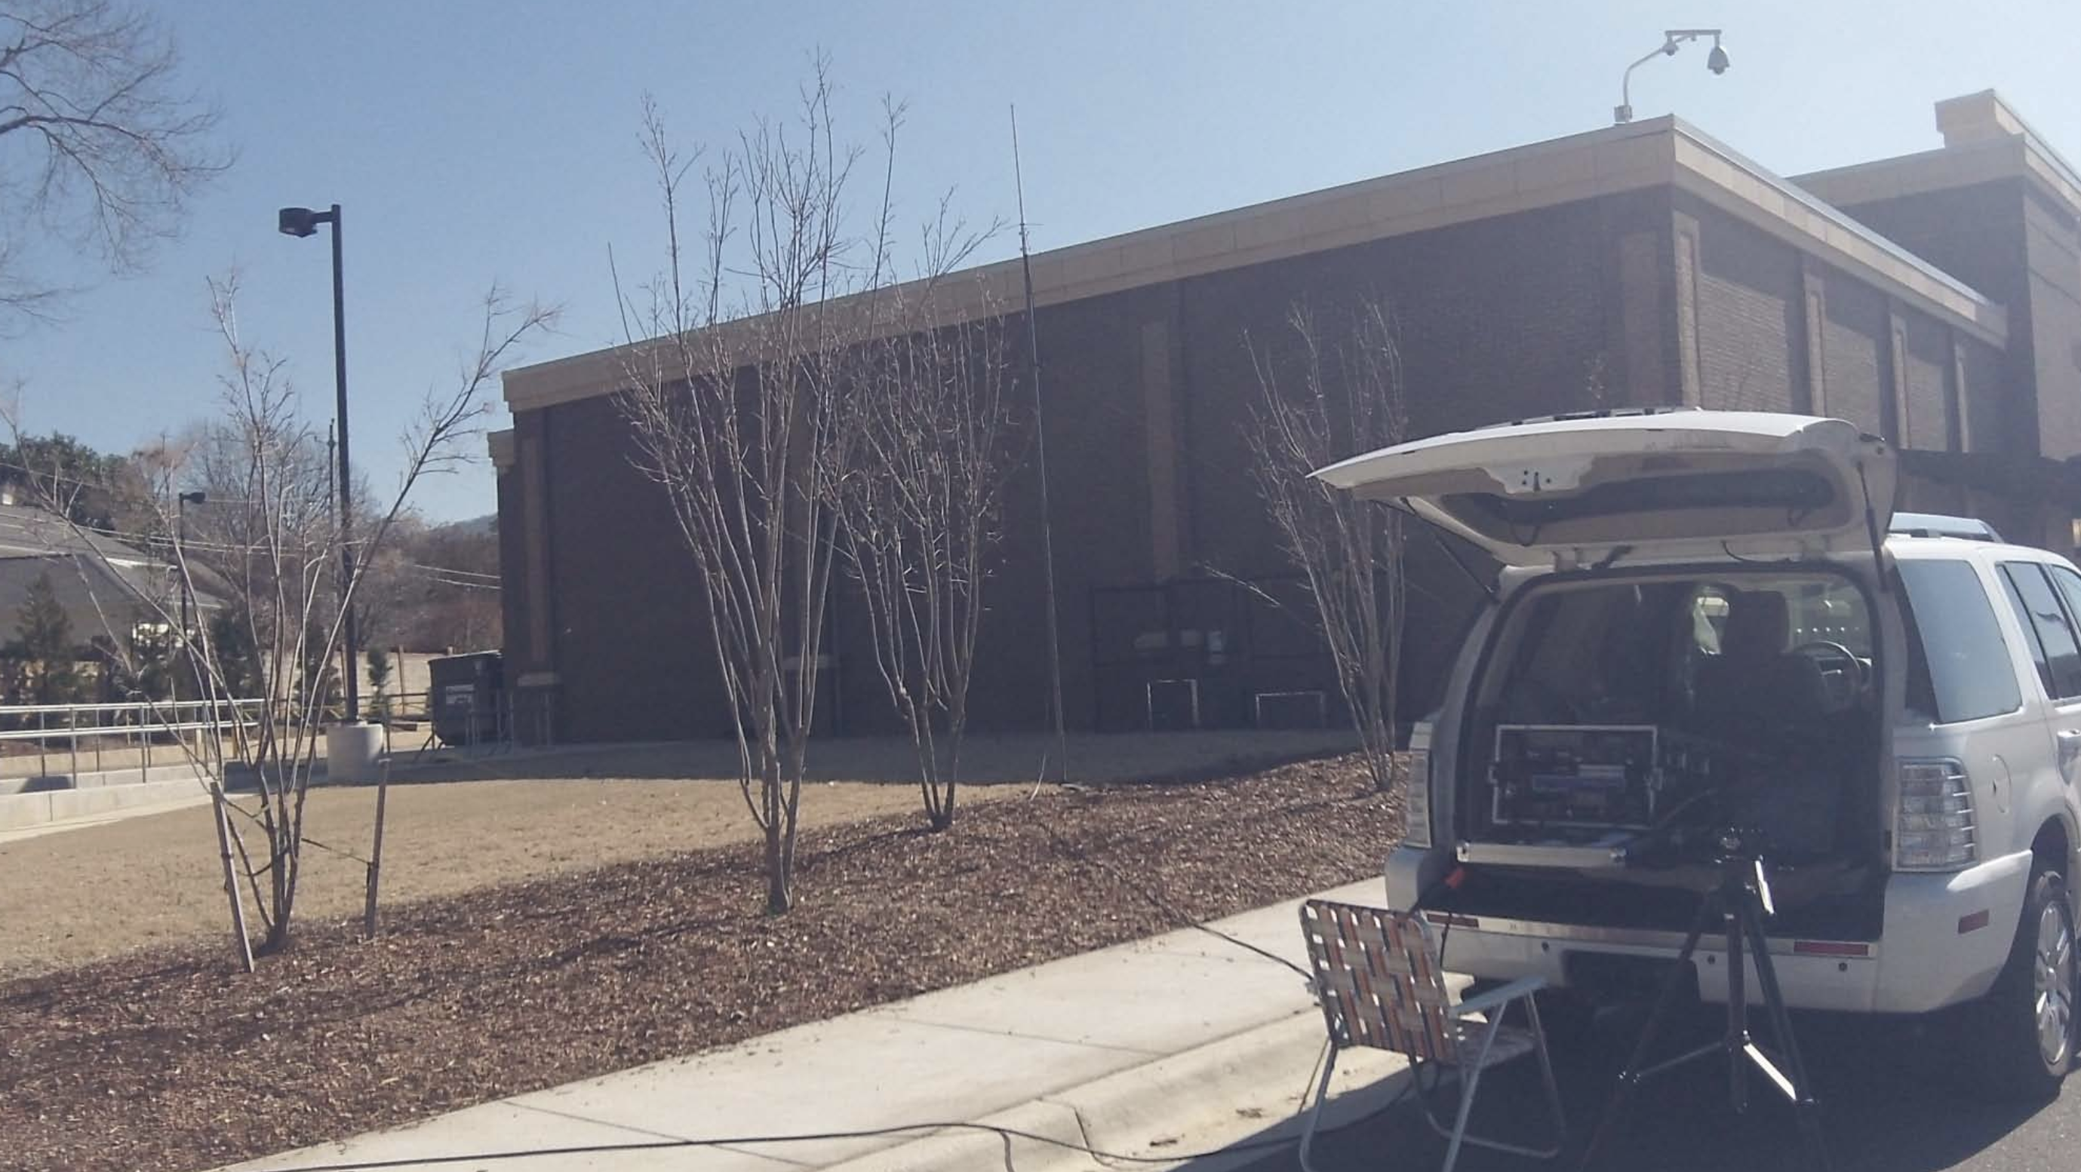
DEPLOYMENT EXAMPLES

Slide 22

ARES GO KIT QUESTIONS?

Slide 23

THAT’S ALL FOLKS

