Slide 1
My Name: Lori Bedford
My Calls: VE3VAI and VE3VBA
Experience:
Navy Signalman
Red River Community College: Radiocommunications and Electronic Technology
Canadian Coast Guard Radio Operator 25 Years
8 Coast Guard Radio Stations ….West Coast….Arctic….Great Lakes
Cruise Ship Radio Officer 3 years
Amateur Radio
RMS Packet Sysop
RMS Trimode Sysop (currently have set up for VARA FM)

Slide 2
Basics of Message Handling
Voice Procedures

Slide 3
Phonetic Alphabet
A ALFA B BRAVO C CHARLIE D DELTA E ECHO
F FOTROT G GOLF H HOTEL I INDIA J JULIET
K KILO L LIMA M MIKE N NOVEMBER
O OSCAR P PAPA(PA-PA’) Q QUEBEC(KAY-BEK’) R ROMEO
S SIERRA T TANGO U UNIFORM V VICTOR
W WHISKEY X X-RAY Y YANKEE Z ZULU
Numbers
1 ONE 2 TWO 3 THREE(TREE) 4 FOUR 5 FIVE (FIFE)
6 SIX 7 SEVEN 8 EIGHT 9 NINE (NINER) 0 ZERO
Learn These…..Do not make up your own

Slide 4
Key Words Avoid Q Codes
AFFIRMATIVE Yes. (Preferred)
Be aware some may use Charlie but prefer to use Affirmtive
CHARLIE Yes. CONFIRM ___ The request to confirm correct copy of group(s). The affirmative reply to the request.
NEGATIVE No.
ROGER Received and understood. (Does NOT mean yes, confirm, charlie, or affirmative!).
OVER End of transmission, invitation to transmit.
GO AHEAD Continue. Used after requesting fills after interruptions to signal the sending operator to continue. Also used as an equivalent to OVER.
Break Separation between Message parts
Figures “ Figures 17” would be copied as 17 not one seven.
Initials in a name or acronym such as ARES spoken as “ initials Alpha Romeo Echo Sierra”

Slide 5
Key Words
I Spell
Used to indicate you are going back to spell the word or group just voiced.
Example“ John Froeze I spell Foxtrot Romeo Oscar Echo Zulu Echo”
I Say Again
Used to repeat for Clarity either a single word or phrase
Example
“ Fort William Garden I say again Fort William Garden”
Amateur Call
Used to introduce an amateur call sign in the Address, Text, or Signature (but not in the Preamble). Phonetics are mandatory for the letters; as in:
VE3VAI: voiced as "amateur call VICTOR ECHO THREE (TREE) VICTOR ALPHA INDIA

Slide 6
FILL REQUESTS AND RESPONSES
[IN (part)] WORD AFTER _____; Respond with group or part requested;
Example: In text word after severe: Response: “Word after severe lightning
[IN (part)] WORD BEFORE _____; Respond with group or part requested;
[IN (part)] ALL AFTER _____; Respond with all groups after the one specified to the end of the message, unless limited;
[IN (part)] ALL BEFORE _____; Respond with all groups in the message to the group specified, unless limited;
[IN (part)] BETWEEN _____ AND _____; Respond with group(s) between blanks, observing limits;
[IN (part)] CONFIRM ____ ; Respond "CONFIRM" or “AFFIRMATIVE” if group(s) correct. Otherwise voice the correct group(s), (spelling helps); (part name); Simply state the part name, thus asking for a repeat of that part. Respond by re-sending the requested part;
[IN (part)] SPELL [PHONETICALLY]... , may be used ahead of fill requests. Respond by spelling word groups with “I spell

Slide 7
Radiogram
There are 4 parts to a Radiogram (IMS 213 -R)
Preamble
Address
Text
Signature

Slide 8
Preamble

Slide 9
Address

Slide 10
Text

Slide 11
Signature

Slide 12
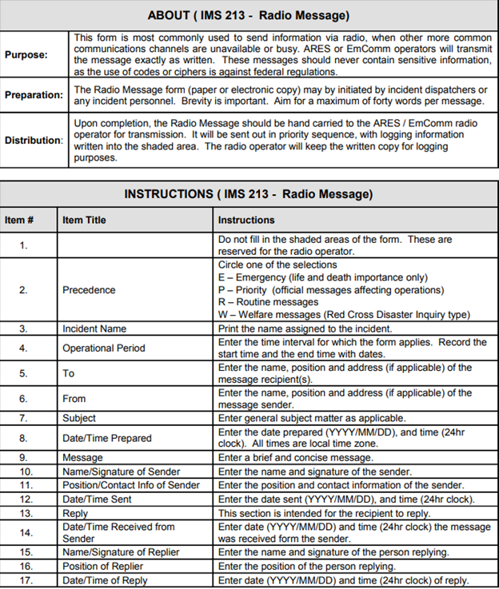

Slide 13
Message preparation

Slide 14
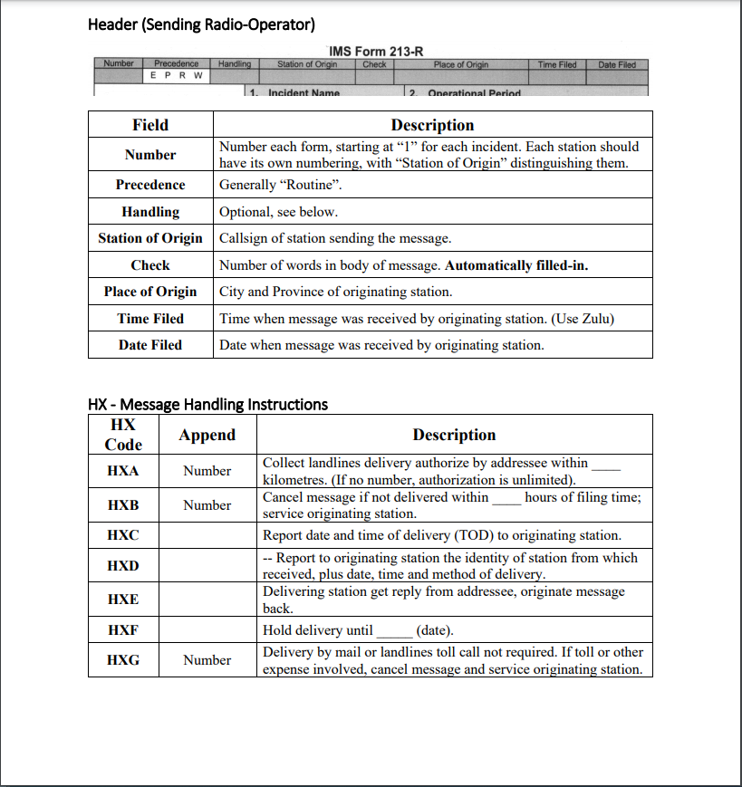

Slide 15
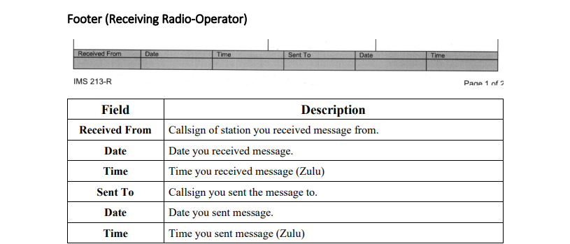

Slide 16
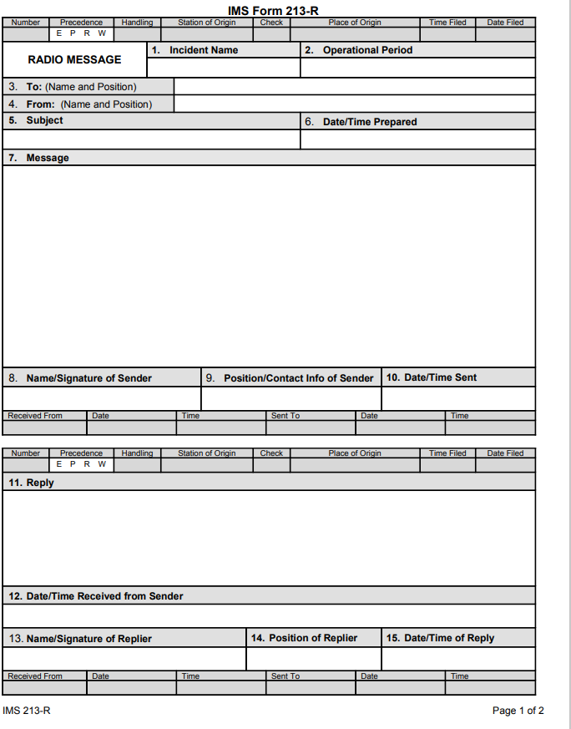
Radio Operator
mMessage Originator
Grey Areas filled by Radio Operator
White Boxes filled in by the Originator
Radio Operator

Slide 17
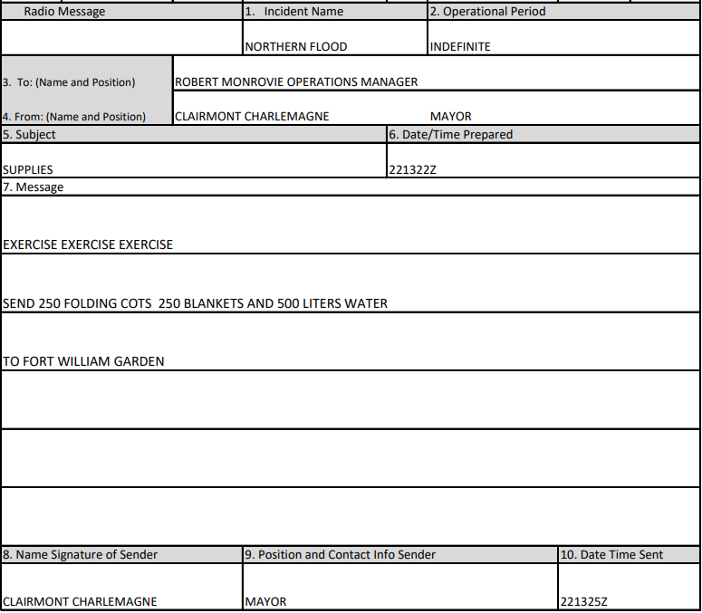
Message Prepared by the Originator

Slide 18
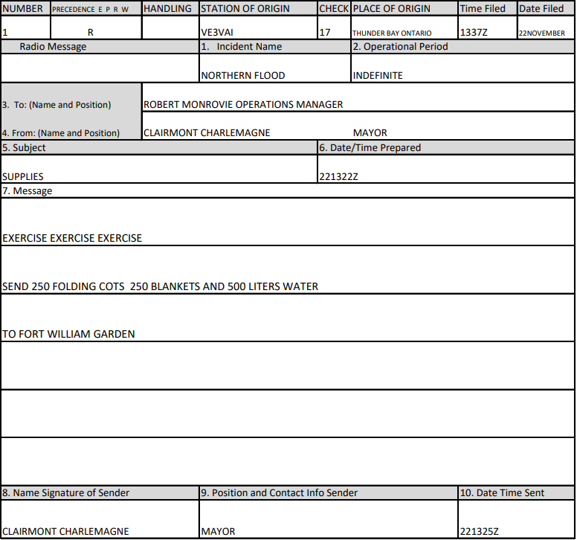
Radio Operator receives the message from the Originator and adds the Preamble
Radio Operator Fills in When Received from Originator

Slide 19
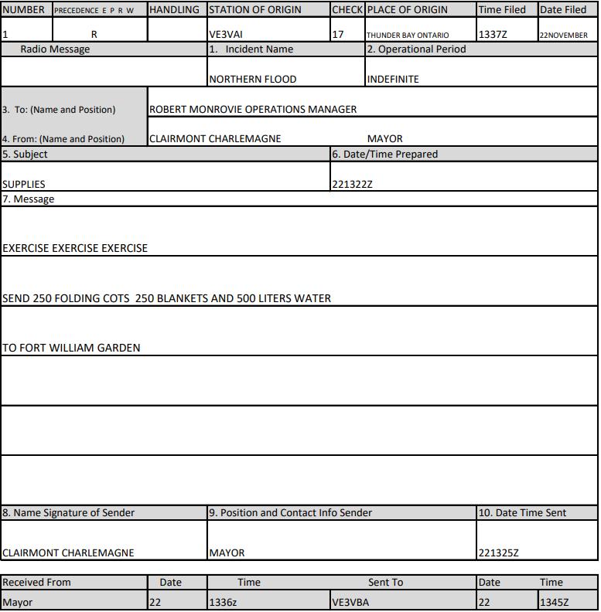
Radio Operator Fill when message delivered

Slide 20
Message Delivery
Speed of Delivery
Don’t Rush….Remember speed of delivery will depend on the prevailing conditions and capabilities of the Receiving Operator. It is better
to get it right the first time and avoid requests for fill ins. The receiving station may have a noisy environment, could be fading signals, static crashes etc or the operator simply copying with
pencil and paper and has to slowly print it out.

Slide 21
Establishing Contact

Slide 22
Initial Call
Response
Purpose
Ready

Slide 23
The Message

Slide 24
VE3VAI SENDS MESSAGE

Slide 25
Request for Fills
Response
Request for Fill
Response
Acknowledgement

Slide 26
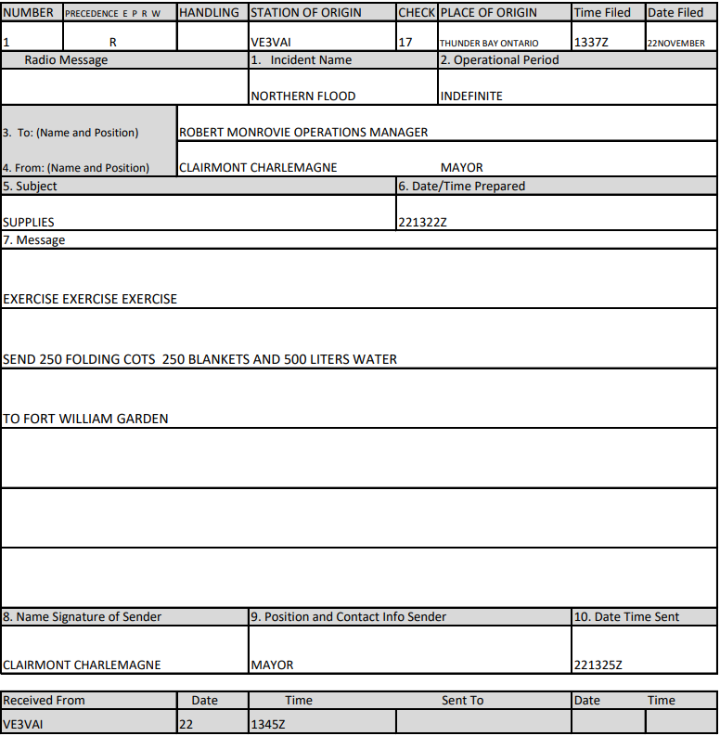
VE3VBA COPY
Message Received

Slide 27
THIS IS VE3VAI OUT

