Slide 1
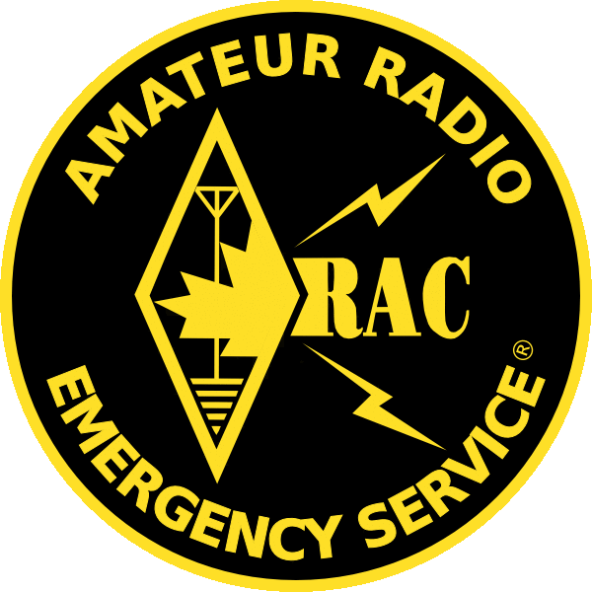
ARES – An Overview
Amateur Radio Emergency Service
Presented by
Woody Linton VE3JJA

Slide 2
What’s the most critical component in Emergency Management COMMUNICATIONS

Slide 3
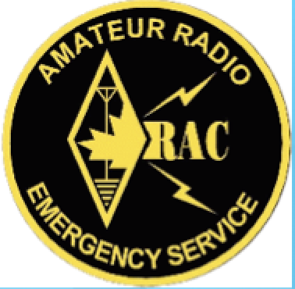
911 We all remember

Slide 4
KATRINA

Slide 5
KATRINA

Slide 6
ARES STATIONS – MAJOR ROLE IN KATRINA

Slide 7
BC EARTHQUAKE

Slide 8
PRIMARY ARES LOCATIONS AS LISTED BELOW

Slide 9
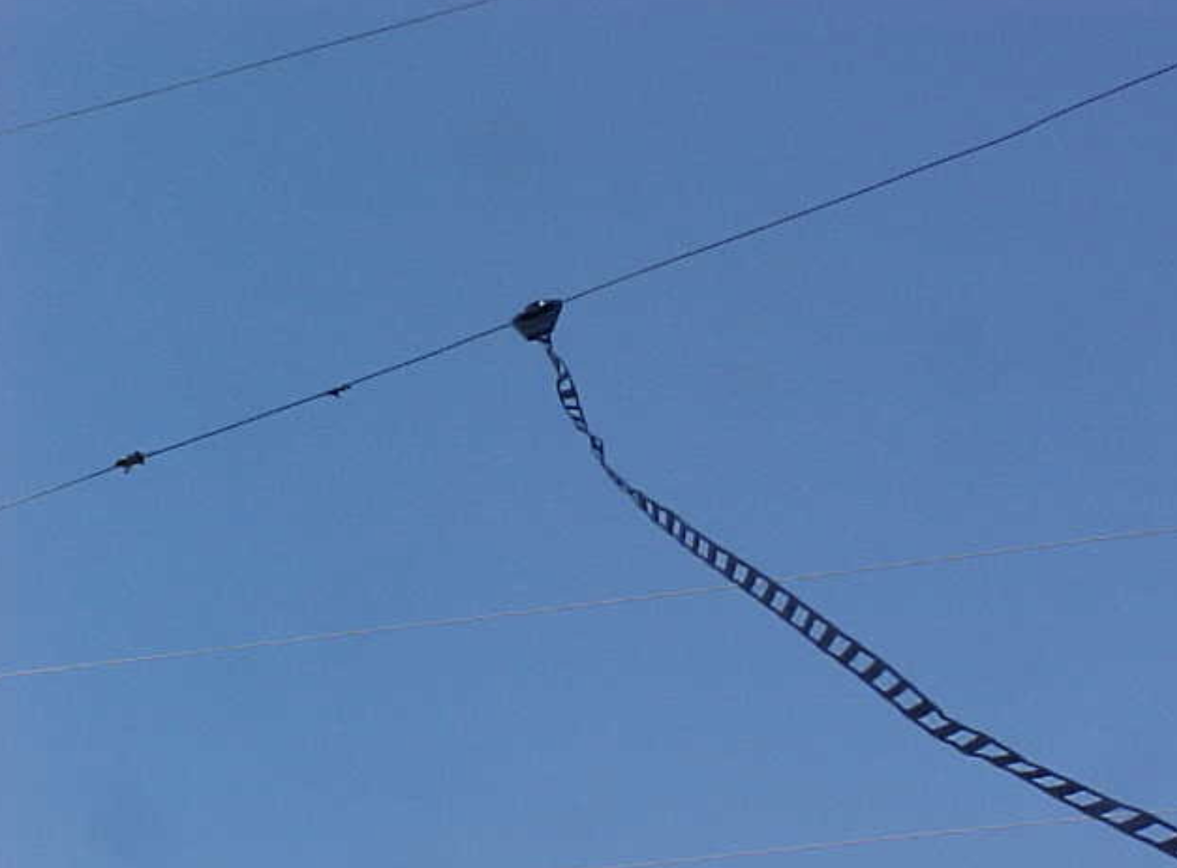
FROM THIS TO THIS

Slide 10
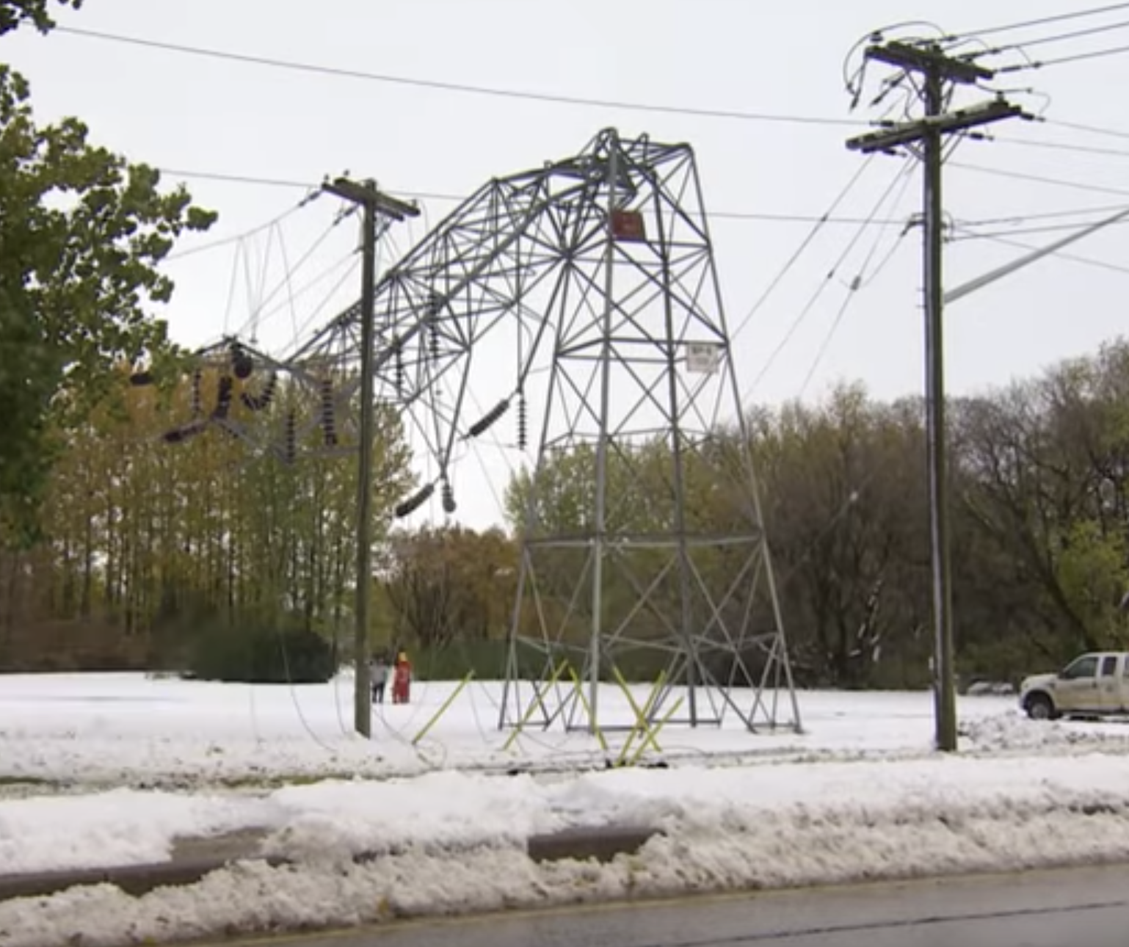
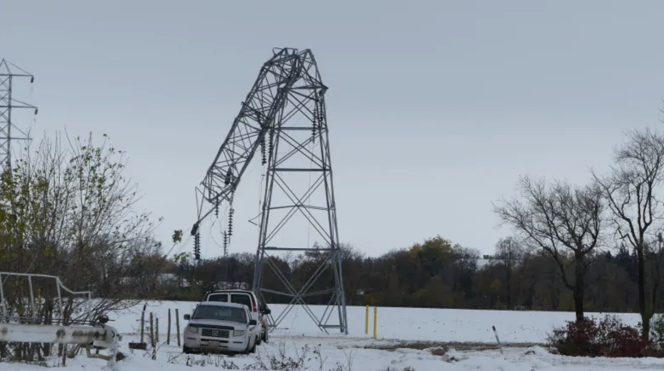
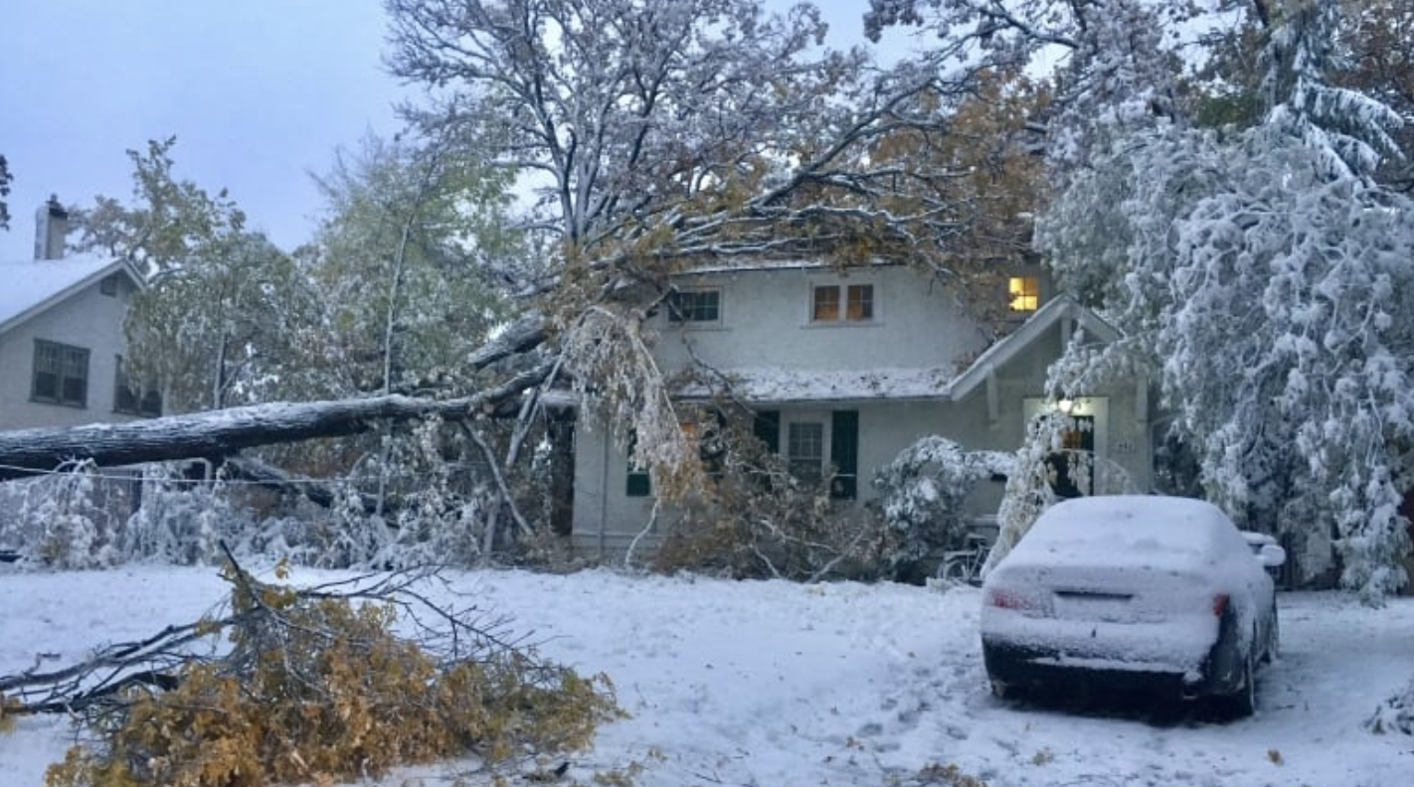
RIGHT HERE IN MANITOBA

Slide 11
WHAT IS A.R.E.S. ?
Amateur
Radio
Emergency
Service

Slide 12
ARES GOALS
To establish and provide emergency communications training for a core group of radio operators able to provide emergency site communications and supervision of the amateur communications network.
Provide peacetime emergency / disaster communications support to Municipalities, Police Services, Red Cross, and other agencies as requested.
Train radio operators to high level of effectiveness and efficiency through radio communications exercises and public service activities.
Foster teamwork and public service among area radio operators.

Slide 13
Introduction to ARES
OVERVIEW:
Amateur Radio Emergency Service (ARES) created by ARRL (Amateur Radio Relay League) in 1935
More than 70,000 ARES members throughout North America
Canadian Amateurs / Red Cross formal agreement of support in 1980
RAC (Radio Amateurs of Canada) formed in 1993 from merger of CRRL (Canadian Radio Relay League) and CARF (Canadian Amateur Radio Federation)
ARES and NTS (National Traffic Service) part of RAC Field Services Organization

Slide 14
Introduction to ARES
ORGANIZATIONAL STRUCTURE:
Field Services Manager – FSM (National)
Section Manager – SM (Provincial)
Section Emergency Coordinator - SEC
District Emergency Coordinator - DEC
Emergency Coordinator – EC (Local)
Assistant Emergency Coordinator – AEC
ARES Registered Stations

Slide 15
INCIDENT COMMAND SYSTEM

Slide 16
LOGISTICS SECTION

Slide 17
Local Organization

Slide 18
Introduction to ARES
RECAP:
ARES – a national structure
Planning is done at the local level
Maintains a “first response” procedure

Slide 19
What do we do?
Through the use of amateur radio frequencies, operators, equipment, and skills, on the request of a recognized authority, we provide to our communities and certain organizations, backup or primary communication resources.

Slide 20
What do we do?
ARES provides communications support only for those agencies requesting assistance
Rarely would we provide any other service, and only if it did not conflict with assigned communications task
Agencies and interaction are spelled out in formal, predetermined understandings
As a support group, ARES does not normally initiate any action
When requested to support, ARES puts their own emergency plan into effect, responding to the situation at hand

Slide 21
What do we do?
SEQUENCE OF EVENTS:
A disaster occurs within the community or service area
Police are notified and respond to the scene
Authorities or police assess the initial situation and call for specific aid
More police
Fire trucks
Public utilities
Ambulances and medical personnel
Hazardous material containment team
Etc.

Slide 22
What do we do?
SEQUENCE OF EVENTS – cont’d:
Specific agencies would be notified and put on standby under the Peacetime Emergency Plan
Social Services become involved when people require food, clothing, or shelter
Red Cross is called if shelters are to be established
ARES will be notified if communications are required
The DEC, EC, or AEC will be called with a request and initial assessment of the situation
DEC, EC, and/or AEC quickly confer to assess requirements and actions required

Slide 23
What do we do?
SEQUENCE OF EVENTS – cont’d:
Initiate call up tree to alert members – assign a temporary net controller to also make announcements on local emergency frequency
Inform members of course of action
Standby
Report to a shelter or office
Report to a central rally point for instructions
Establish a permanent NCS

Slide 24
What do we do?
SEQUENCE OF EVENTS – cont’d:
DEC, EC and/or AEC actions
Meet at EOC or where requested for further instructions and liaison to other agencies
Provide additional communications if requested
Police department
Fire department
Municipal officials
Hospitals
Civic shelters or Red Cross Centres

Slide 25
What do we do?
SEQUENCE OF EVENTS – cont’d:
DEC, EC and/or AEC actions
Continue until requested to stand down
Conduct a debriefing after the event to learn valuable lessons

Slide 26
What do we do?
RECAP:
ARES is called by Municipal officials
Alert members via call up methods
Set up at EOC (Emergency Operations Centre)
Establish scheduling and logistics support
Provide communications as requested
Learn from the event

Slide 27
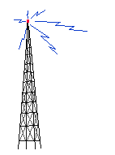
Sample of Communication System VHF/UHF
VE4??
Shelter Two
VHF
VE4??
Hospital
VHF
VE4??
EOC
Net Control
HF/VHF
VE4??
Red Cross
VHF
VE4??
Emergency
Site
VHF
Voice / Digital

Slide 28
Sample of Communication System HF
Voice / Digital
VE4??
Portage
EOC
HF
VA4??
Gimli
EOC
HF
VA4??
Falcon Lake
EOC
HF
VE4??
Hospitals
VHF
VE4??
Brandon
EOC
HF
VE4??
EMO WPG
EOC
VE4??
Franklen Emerson
EOC
HF
VE4??
Winkler
HF
VE4??
Morris
EOC
HF
VE4??
Emergency Sites
HF

Slide 29
Establishing a Station
The ARES Emergency Coordinator will authorize the establishment of stations.
The station location should be pre-determined in the emergency plan, with alternate locations.
The station will consist of a station supervisor, operator, and logger.
Messages should be handled according to standard procedure.

Slide 30
ARES EOC

Slide 31
ARES COMM POST

Slide 32
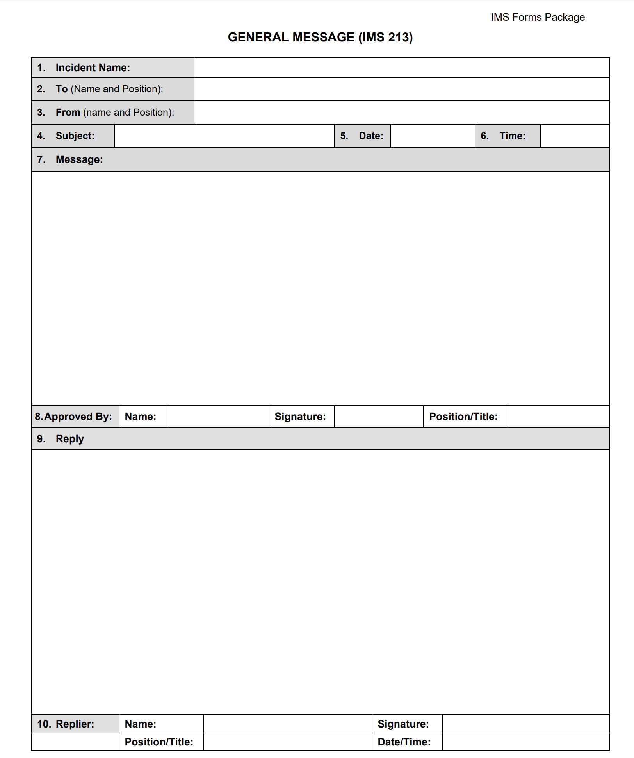
Standard IMS 213 Message Form

Slide 33
Message Handling
A IMS Message contains ten parts”
1 Incident name
2 To:
3 From:
4 , 5 , 6 Subject … Date & Time
7 Message
8 Approved by Name Sig & Position
9 Reply
10 Replier

Slide 34
An ARES Volunteer
What is expected of them:
While in the event of an actual emergency, ARES volunteers may be asked to participate in telecommunication operations, it is recognized that first and foremost, volunteers must address their own personal safety needs and those of their loved ones.
Once the volunteer’s immediate needs are addressed, they are better able to serve the public as part of an ARES team.

Slide 35
Technology
Voice
Winlink (email without internet)
ATV, SSTV
Repeaters
GPS tracking/ APRS
CanWarn
Satellite

Slide 36
WINLINK

Slide 37
WINLINK EMAIL

Slide 38
Team/Resources
Our Resources
Equipment
Municipal Funding & Grants) to establish permanent EOC ARES Stations
Personal base, mobile and portable equipment owned by individual radio amateurs
Includes computers, laptops, antenna systems and structures, backup generators, cameras, test equipment, etc.

Slide 39
Team/Resources
Our Resources
Locations
Radio amateurs are resident in many areas
Geographical area is very large with seasonal fluctuations in Amateur population density
Repeater coverage includes almost all of Southern Manitoba

Slide 40
Team/Resources
Our Resources
Support & outside services
Entire ARES organization – district, province, national and international
National Traffic Service
All radio amateurs, members and non-members of ARES

Slide 41
Procedures
Clearly defined organization structure, protocols, procedures, methods, and operations
Official recognition in municipal plans
Regular training and testing of resources
Upgrading, installation, and maintenance of radio equipment.

Slide 42
CONTACTS ARES MANITOBA
Section Emergency Coordinator
Jeffrey Dovyak VE4MBQ
39 Allen Blye Drive
Winnipeg MB
204.694.8146
email: ve4mbq@mts.net
Southern Region District Emergency Coordinator
Gordon Snarr VE4GLS
Box 13 RR#3
Morris MB R0G 1K0
Tel: 204.746.2743
Cell: 202.781.1913
email: ve4gls@rac.ca
Northern Region & Special Projects
Wayne Warrren, VE4WR
408 Hillary Cresent
Winnipeg MB R2Y 0Y7
Tel: 204.889.3584
email: wrwarren@mymts.net

Slide 43
Questions

Slide 44
That’s the ARES Overview
ARES MEMBERS LOOK FORWARD TO SERVING YOUR COMMUNITIES
Amateur Radio Emergency Service

